Slide 1


Idiomatic Programmer Learning Keras
Computer Vision Workshop - UCLA CS168 - 2019

Slide 2
Idiomatic Programmer Learning Keras
Repo: github.com/GoogleCloudPlatform/keras-idiomatic-programmer
Slides and Handbooks:
are under ‘GDG workshop’ subdirectory

Slide 3
Computer Vision Workshop - 2019
Presumptions
You know Python - won’t cover programming
You know Neural Network basics - won’t cover theory of NN
You know Image Formats - won’t cover pixels, channels, etc.
You have some knowledge of CNNs - won’t cover theory.
Goal(s):
Introduce you to Keras ML framework as it relates to computer vision to get you started.
Will only cover classification methods (not object detection or segmentation).
Will use openCV (not GluonCV - not familiar with it)

Slide 4
Install
Packages to Install
I assume you have Python installed (preferably version 3). Whether you directly installed it, or it got installed as part of a larger package, like Anaconda, you got with it a nifty command like tool called pip. This tool is used to install any Python package you will ever need again from a single command invocation. You go pip install and then the name of the package.
cmd> pip install keras
cmd> pip install tensorflow
cmd> pip install numpy
cmd> pip install python-opencv

Slide 5
Computer Vision Workshop - 2019
Session 1 : Models
Session 2 : Data Engineering
Session 3 : Training & Deployment

Slide 6
Neural Networks - Input Class
Input Class
Keras is based on object oriented programming with a collection of classes and associated methods and properties.
We instantiate an Input class object. For this class object, we define the shape (i.e., dimensions) of the input. In our example, the input is a one dimensional array (i.e., vector) of 13 elements, one for each feature.
from keras import Input Input(shape=(13,))

Slide 7
Neural Networks - Input Class
Input Class
When you run the previous two lines in a notebook, you will see the output:
<tf.Tensor 'input_1:0' shape=(?, 13) dtype=float32>
This is showing you what Input(shape=(13,)) evaluates to. It produces a tensor object by the name 'input_1:0'. This name will be useful later in assisting you in debugging your models. The '?' in shape shows that the input object takes an unbounded number of entries (your samples or rows) of 13 elements each. That is, at run-time it will bind the number of one dimensional vectors of 13 elements to the actual number of samples (rows) you pass in. The 'dtype' shows the default data type of the elements, which in this case is a 32-bit float (single precision).

Slide 8
Neural Networks - Feed Forward
Feed Forward
The DNN (and CNN) are known as feed forward neural networks. This means that data moves through the network sequential in one direction (from input to output layer). That's like a function in procedural programming. The inputs are passed as parameters (i.e., input layer), the function performs a sequenced set of actions based on the inputs (i.e., hidden layers) and outputs a result (i.e., output layer).
There are two distinctive styles, which you will see in blogs, when coding a forward feed network in Keras. I will briefly touch on both so when you see a code snippet in one style you can translate it to the other.
Sequential Method
Functional (Layers) Method

Slide 9
Neural Networks - Keras Sequential Method
The Sequential Method Approach
The Sequential method is easier to read and follow for beginners, but the trade off is its less flexible. Essentially, you create an empty forward feed neural network with the Sequential class object, and then "add" one layer at a time, until the output layer.
from keras import Sequential model = Sequential() model.add( /the first layer/ ) model.add( /the next layer/ ) model.add( /the output layer/ )

Slide 10
Neural Networks - Keras Sequential Method
The Sequential Method Approach (List)
The layers in the neural network may alternately be specified as a list in a sequential order which is passed as a parameter when instantiating the Sequential class object.
from keras import Sequential model = Sequential([ /the first layer/, /the next layer/, /the output layer/ ])

Slide 11
Neural Networks - Keras Functional Method
The layers Approach (Functional Method)
The layers approach is more advanced. You build the layers separately and then "tie" them together. This latter step gives you the freedom to connect layers in creative ways. Essentially, for a forward feed neural network, you create the layers, bind them to another layer(s), and then pull all the layers together in a final instantiation of a Model class object.
from keras import Model from keras.layers import layers input = layers.(/the first layer/) hidden = layers.(/the next layer/)( /the layer to bind to/ ) output = layers.(/the output layer/)( /the layer to bind to/ ) model = Model(input, output)

Slide 12
Neural Networks - Dense Layer
The Dense() Layer
In Keras, layers in a fully connected neural network (FCNN) are called Dense layers.
A Dense layer is defined as having "n" number of nodes, and is fully connected to the previous layer. Let's continue and define in Keras a three layer neural network, using the Sequential method. Our input layer will be ten nodes, and take as input a thirteen element vector (i.e., the thirteen features), which will be connected to a second (hidden) layer of ten nodes, which will then be connected to a third (output) layer of one node.
This is an example where we are going to use a neural network as a regressor. That means, the neural network will output a single real number.
input layer = 10 nodes
hidden layer = 10 nodes output layer = 1 node

Slide 13
Neural Networks - Sequential Example
Sequential Approach Example - Three Layer FCNN
Let's first do this using the Sequential method. In the example below, we have three add() calls to the class object Dense(). The add() method "adds" the layers in the same sequential order we specified them in. The first (positional) parameter is the number of nodes, ten in the first and second layer and one in the third layer. Notice how in the first Dense() layer we added the (keyword) parameter input_shape. This is where we will define the input vector and connect it to the first (input) layer in a single instantiation of Dense().
from keras import Sequential from keras.layers import Dense model = Sequential() # Add the first (input) layer (10 nodes) with input shape 13 element vector (1D). model.add(Dense(10, input_shape=(13,))) # Add the second (hidden) layer of 10 nodes. model.add(Dense(10)) # Add the third (output) layer of 1 node. model.add(Dense(1))

Slide 14
Neural Networks - Sequential Example
Sequential Approach Example (as List) - Three Layer FCNN
Alternatively, using the Sequential method, we will add the three layers by specifying them in a list in sequential order, and pass the list as a parameter when instantiating the Sequential() class object.
from keras import Sequential from keras.layers import Dense model = Sequential([ # Add the first (input) layer (10 nodes) Dense(10, input_shape=(13,)), # Add the second (hidden) layer of 10 nodes. Dense(10), # Add the third (output) layer of 1 node. Dense(1) ])

Slide 15
Neural Networks - Layers Example
Layer Approach Example - Three Layer FCNN
Let's now do the same using the layers method. We start by creating an input vector by instantiating a Input() class object. The (positional) parameter to the Input() class is the shape of the input, which can be a vector, matrix or tensor. In our example, we have a vector that is thirteen elements long. So our shape is (13,).
from keras import Input, Model # Create the input vector (13 elements). inputs = Input((13,))

Slide 16
Neural Networks - Layers Example
Layer Approach Example - Connect Input Layer
Next, we create the input layer by instantiating a Dense() class object. The positional parameter to the Dense() class is the number of nodes; which in our example is ten. Note the peculiar syntax that follows with a (inputs). The Dense() object is a callable. That is, the object returned by instantiating the Dense() class can be callable as a function. So we call it as a function, and in this case, the function takes as a (positional) parameter the input vector (or layer output) to connect it to; hence we pass it inputs so the input vector is bound to the ten node input layer.
from keras import Input, Model from keras.layers import Dense # Create the input vector (13 elements). inputs = Input((13,)) # Create the first (input) layer (10 nodes) and connect it to the input vector. input = Dense(10)(inputs)

Slide 17
Neural Networks - Layers Example
Layer Approach Example - Connect Hidden and Output Layers
Next, we create the hidden layer by instantiating another Dense() class object with ten nodes, and using it as a callable, we (fully) connect it to the input layer. Then we create the output layer by instantiating another Dense() class object with one node, and using it as a callable, we (fully) connect it to the hidden layer.
Finally, we put it altogether by instantiating a Model() class object, passing it the (positional) parameters for the input vector and output layer.
from keras import Input, Model from keras.layers import Dense # Create the input vector (13 elements). inputs = Input((13,)) # Create the first (input) layer (10 nodes) and connect it to the input vector. input = Dense(10)(inputs) # Create the next (hidden) layer (10 nodes) and connect it to the input layer. hidden = Dense(10)(input) # Create the output layer (1 node) and connect it to the previous (hidden) layer. output = Dense(1)(hidden) # Now let's create the neural network, specifying the input layer and output layer. model = Model(inputs, output)

Slide 18
Neural Networks - ReLU Activations
Adding ReLU Activation between Layers
The rectified linear unit is generally used between layers. In our example, we will add a rectified linear unit between each layer.
from keras import Sequential from keras.layers import Dense, ReLU model = Sequential() # Add the first (input) layer (10 nodes) with input shape 13 element vector (1D). model.add(Dense(10, input_shape=(13,))) # Pass the output from the input layer through a rectified linear activation function. model.add(ReLU()) # Add the second (hidden) layer (10 nodes). model.add(Dense(10)) # Pass the output from the input layer through a rectified linear activation function. model.add(ReLU()) # Add the third (output) layer of 1 node. model.add(Dense(1))

Slide 19
Neural Networks - Model Summary
Getting a Summary of the Model Architecture
Let's take a look inside our model object and see if we constructed what we think we did. You can do this using the summary() method. It will show in sequential order a summary of each layer.
model.summary()
Layer (type) Output Shape Param # ================================================================= dense_56 (Dense) (None, 10) 140 _________________________________________________________________ re_lu_18 (ReLU) (None, 10) 0 _________________________________________________________________ dense_57 (Dense) (None, 10) 110 _________________________________________________________________ re_lu_19 (ReLU) (None, 10) 0 _________________________________________________________________ dense_58 (Dense) (None, 1) 11 ================================================================= Total params: 261 Trainable params: 261 Non-trainable params: 0

Slide 20
Neural Networks - Shorthand Syntax
Shorthand Syntax
Keras provides a shorthand syntax when specifying layers. You don't actually need to separately specify activation functions between layers, as we did above. Instead, you can specify the activation function as a (keyword) parameter when instantiating a Dense() layer.
The code below does exactly the same as the previous code sample.
from keras import Sequential from keras.layers import Dense model = Sequential() # Add the first (input) layer (10 nodes) with input shape 13 element vector (1D). model.add(Dense(10, input_shape=(13,), activation='relu')) # Add the second (hidden) layer (10 nodes). model.add(Dense(10, activation='relu')) # Add the third (output) layer of 1 node. model.add(Dense(1))

Slide 21
Neural Networks - Compile
Optimizer (Compile)
Once you've completed building the forward feed portion of your neural network, as we have for our simple example, we now need to add a few things for training the model. This is done with the compile() method. This step adds in the backward propagation during training.
Each time we send data (or a batch of data) forward through the neural network, the neural network calculates the errors in the predicted results (loss) from the actual values (labels) and uses that information to incrementally adjust the weights and biases of the nodes - what we are "learning".

Slide 22
Neural Networks - Loss Function
Calculating the Loss
The calculation of the error is called a loss. It can be calculated in many different ways. Since we designed our neural network to be a regresser, we want to use a loss function that is best suited for a regresser. Generally, for this type of neural network, the Mean Square Error method of calculating a loss is used. The compile() method takes a (keyword) parameter loss where we can specify how we want to calculate it. We are going to pass it the value 'mse' for Mean Square Error.

Slide 23
Neural Networks - Optimizer
Optimizer - Convergence
The next step in the process is the optimizer that occurs during backward propagation. The optimizer is based on gradient descent; where different variations of the gradient descent algorithm can be selected.
Essentially, each time we pass data through the neural network we use the calculated loss to decide how much to change the weights and biases in the layers by. The goal is to gradually get closer and closer to the correct values for the weights and biases to accurately predict (estimate) the "label" for each sample.
This process of progressively getting closer and closer is called convergence.
For our regresser neural network we will use the rmsprop method (root mean square property).
model.compile(loss='mse', optimizer='rmsprop')

Slide 24

Neural Networks - Binary Classifier
DNN Binary Classifier
Another form of a DNN, is a binary classifier (logistic classifier). In this case, we want the neural network to predict whether something is or is not something. That is, the output can have two states: yes/no, true/false, 0/1, etc.
Instead of using a linear activation function on the output node, we will use a sigmoid activation function. The sigmoid squashes all values to be between 0 and 1, and as values move away from the center they quickly move to the extremes of 0 and 1.

Slide 25
Neural Networks - Binary Classifier
Binary Cross Entropy Loss Function
We will now code this in several different styles. Let's start by taking our previous code example, where we specify the activation function as a (keyword) parameter. In this example, we add to the output Dense() layer the parameter activation='sigmoid' to pass the output result from the final node through a sigmoid function.
Next, we are going to change our loss parameter to 'binary_crossentropy'. This is the loss function that is generally used in a binary classifier (logistic classifier).
from keras import Sequential from keras.layers import Dense model = Sequential() # Add the first (input) layer (10 nodes) with input shape 13 element vector (1D). model.add(Dense(10, input_shape=(13,), activation='relu')) # Add the second (hidden) layer (10 nodes). model.add(Dense(10, activation='relu')) # Add the third (output) layer of 1 node, and set the activation function to a Sigmoid. model.add(Dense(1, activation='sigmoid')) # Use the Binary Cross Entropy loss function for a Binary Classifier. model.compile(loss='binary_crossentropy', optimizer='rmsprop', metrics=['accuracy'])

Slide 26
Neural Networks - Binary Classifier
Layers Approach
Now we will rewrite the same code using the layers approach. Notice how we repetitively used the variable x. This is common. We want to avoid creating lots of one-time use variables. Since we know in this type of neural network, the output of every layer is the input to the next layer (or activation), except for the input and output, we just use x as the connecting variable.
from keras import Sequential, Model, Input from keras.layers import Dense, ReLU, Activation # Create the input vector (13 elements) inputs = Input((13,)) # Create the first (input) layer (10 nodes) and connect it to the input vector. x = Dense(10)(inputs) # Pass the output from the input layer through a rectified linear activation function x = Activation('relu')(x) # Create the next (hidden) layer (10 nodes) and connect it to the input layer. x = Dense(10)(x) x = Activation('relu')(x) x = Dense(1)(x) output = Activation('sigmoid')(x) # Now let's create the neural network, specifying the input layer and output layer. model = Model(inputs, output)

Slide 27
Neural Networks - Multi-Class Classifier
Softmax Activation Function
Next, we will change the activation function in our example to 'softmax'. Then we will set our loss function to 'categorical_crossentropy'. This is generally the most common used for multi-class classification. Finally, we will use a very popular and widely used variant of gradient descent called the Adam Optimizer ('adam'). Adam incorporates several aspects of other methods, such as rmsprop (root mean square) and adagrad (adaptive gradient), along with an adaptive learning rate. It's generally considered best-in-class for a wide variety of neural networks.
from keras import Sequential from keras.layers import Dense model = Sequential() # Add the first (input) layer (10 nodes) with input shape 4 element vector (1D). model.add(Dense(10, input_shape=(4,), activation='relu')) # Add the second (hidden) layer (10 nodes). model.add(Dense(10, activation='relu')) # Add the third (output) layer of 5 nodes, and set the activation function to a Softmax. model.add(Dense(5, activation='softmax')) # Use the Categorical Cross Entropy loss function for a Multi-Class Classifier. model.compile(loss='categorical_crossentropy', optimizer='adam', metrics=['accuracy'])

Slide 28
Neural Networks - Flattening
Flattening Layer
In our next example below, we add a layer at the beginning of our neural network to flatten the input, using the class Flatten. The remaining layers and activations are typical for the MNIST dataset.
from keras import Sequential from keras.layers import Dense, Flatten, ReLU, Activation model = Sequential() # Take input as a 28x28 matrix and flatten into a 784 vector model.add(Flatten(input_shape=(28,28))) # Add the first (input) layer (512 nodes) with input shape 784 element vector (1D). model.add(Dense(512)) model.add(ReLU()) # Add the second (hidden) layer (512 nodes). model.add(Dense(512)) model.add(ReLU()) # Add the third (output) layer (10 nodes) with Sigmoid activation function. model.add(Dense(10)) model.add(Activation('sigmoid')) # Use the Categorical Cross Entropy loss function for a Multi-Class Classifier. model.compile(loss='categorical_crossentropy', optimizer='adam', metrics=['accuracy'])

Slide 29
Neural Networks - Overfitting
Overfitting
During training, a dataset is split into training data and test data. Only the training data is used during the training of the neural network. Once the neural network has reached convergence, training stops.
Afterwards, the training data is forward feed again without backward propagation enabled (i.e., no learning) to obtain an accuracy. In a train/test, the test data, which has been set aside and not used as part of training, is forward feed again without backward propagation enabled to obtain an accuracy.
Ideally, the accuracy on the training data and the test data will be nearly identical. In reality, the test data will always be a little less.
Once you reach convergence, continually passing the training data through the neural network will cause the neurons to more and more fit the data samples versus generalizing. This is known as overfitting. When the neural network is overfitted to the training data, you will get high training accuracy, but substantially lower accuracy on the test/evaluation data.

Slide 30
Neural Networks - Dropout
Dropout
Regularization is a method to address overfitting when training neural networks. The most basic type of regularization is called dropout. Dropout is like forgetting.
The dropout technique in neural networks mimics this process. Between any layer you can add a dropout layer where you specify a percentage (between 0 and 1) to forget. The nodes themselves won't be dropped, but instead a random selection on each forward feed will not pass a signal forward (forget).
from keras import Sequential from keras.layers import Dense, Flatten, ReLU, Activation, Dropout model = Sequential() model.add(Flatten(input_shape=(28,28))) model.add(Dense(512)) # Add dropout of 50% at the input layer. model.add(Dropout(0.5)) model.add(ReLU()) model.add(Dense(512)) # Add dropout of 50% at the hidden layer. model.add(Dropout(0.5)) model.add(ReLU())

Slide 31
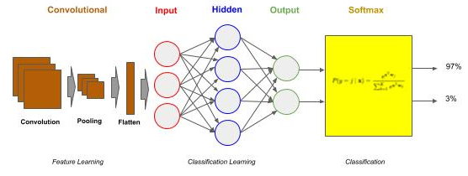
Convolutional Neural Networks
Convolutional Neural Networks (CNN)
Convolutional Neural Networks (CNN) are a type of neural network that can be viewed as consisting of two parts, a frontend and a backend. The backend is a deep neural network (DNN). The name convolutional neural network comes from the frontend, referred to as a convolutional layer(s). The frontend acts as a preprocessor.
The DNN backend does the "classification learning". The CNN frontend preprocesses the image data into a form which is computationally practical for the DNN to learn from. The CNN frontend does the "feature learning".

Slide 32
Convolutional Neural Networks - Filters
Filters are Learned
Prior to neural networks, imaging scientists hand designed these filters. Today, the filters along with the weights in the neural network are "learned".
In a convolutional layer, one specifies the size of the filter and the number of filters. Typical filter sizes are 3x3 and 5x5, with 3x3 the most common.
The number of filters varies more, but they are typically multiples of 16, such as 16, 32 or 64 are the most common.

Slide 33
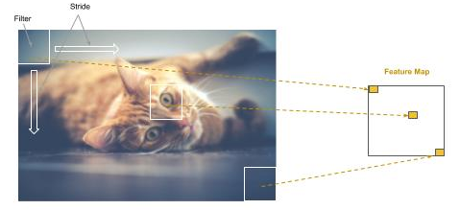
CNN - Feature Maps
Feature Maps
Additionally, one specifies a stride. The stride is the rate that the filter is slid across the image. For example, if the stride is one, the filter advances one pixel at a time, thus the filter would partially overlap with the previous step in a 3x3 filter (and consequently so would a stride of 2). In a stride of 3, there would be no overlap. Most common practice is to use strides of 1 and 2. Each filter that is "learned" produces a feature map, which is a mapping (where) on how strongly the feature is detected in the image.

Slide 34
Convolutional Neural Networks - Pooling
Pooling
Even though each feature map generated is less than the size of the image (e.g., ~75% to 90% reduction), because we generate multiple feature maps (e.g., 16), the total data size has gone up. The next step is to reduce the total amount of data, while retaining the features detected and corresponding spatial relationship between the detected features.
This step is referred to as pooling. Pooling is the same as downsampling (or sub-sampling); whereby the feature maps are resized to a smaller dimension using either max (downsampling) or mean (sub-sampling) pixel average within the feature map.

Slide 35
CNN - Basic Sequential Model
Basic Sequential CNN - Conv2D
We will design a basic sequential model in two parts, the convolutional frontend and the DNN backend. We start by adding a convolutional layer of 16 filters as the first layer using the Conv2D class object.
The size of each filter will be a 3x3, which is specified by the parameter kernel_size and a stride of 2 by the parameter strides. Note that for strides a tuple of (2, 2) is specified instead of a single value 2. The first digit is the horizontal stride (across) and the second digit is the vertical stride (down). It’s a common convention for stride that the horizontal and vertical are the same; therefore one commonly says a “stride of 2” instead of “a 2x2 stride”.
We pick an input size for our images. We like to reduce the size to as small as possible without losing detection of the features. In this case, we choose 128 x 128 (grayscale). The Conv2D class always requires specifying the number of channels, instead of defaulting to one for grayscale; we specified it as (128, 128, 1) instead of (128, 128).
from keras.models import Sequential, Conv2D, MaxPooling2D, Flatten from keras.layers import Dense, ReLU, Activation model = Sequential() # Create a convolutional layer with 16 3x3 filters and stride of two as the input layer model.add(Conv2D(16, kernel_size=(3, 3), strides=(2, 2), padding="same", input_shape=(128,128,1)))

Slide 36
CNN - Basic Sequential Model
Basic Sequential CNN - MaxPooling2D - Flatten
The output from the convolution layer is passed through a rectified linear unit activation, which is then passed to the max pooling layer, using the MaxPool2D class object. The size of the pooling region will be 2x2, specified by the parameter pool_size, with a stride of 2 by the parameter strides. The pooling layer will reduce the feature maps by 75% into pooled feature maps. The pooled feature maps are then flattened, using the Flatten class object, into a 1D vector for input into the DNN. We will glance over the parameter padding. It is suffice for our purposes to say that in almost all cases, you will use the value same; it’s just that the default is not same and therefore you need to explicitly add it.
model = Sequential() # Create a convolutional layer with 16 3x3 filters and stride of two as the input layer model.add(Conv2D(16, kernel_size=(3, 3), strides=(2, 2), padding="same", input_shape=(128,128,1))) # Pass the output (feature maps) from the input layer (convolution) through a rectified linear unit activation function. model.add(ReLU()) # Add a pooling layer to max pool (downsample) the feature maps into smaller pooled feature maps model.add(MaxPooling2D(pool_size=(2, 2), strides=(2, 2))) # Add a flattening layer to flatten the pooled feature maps to a 1D input vector for the DNN classifier model.add(Flatten())

Slide 37
CNN - Basic Sequential Model
Basic Sequential CNN - Attaching the DNN Classifier
Finally, we attach the DNN classifier. In this example, we assume the classifier will be trained for recognizing 26 handwritten lowercase (or hand-signed) characters of the English alphabet.
# Add the input layer for the DNN, which is connected to the flattening layer of the convolutional frontend model.add(Dense(512)) model.add(ReLU()) # Add the output layer for classifying the 26 hand signed letters model.add(Dense(26)) model.add(Activation('softmax')) # Use the Categorical Cross Entropy loss function for a Multi-Class Classifier. model.compile(loss='categorical_crossentropy', optimizer='adam', metrics=['accuracy'])

Slide 38
CNN - Basic Sequential Model
Basic Sequential CNN - Model Summary
Feature Map Size (e.g., 64 x 64)
Layer (type) Output Shape Param # ================================================================= conv2d_1 (Conv2D) (None, 64, 64, 16) 160 _________________________________________________________________ re_lu_1 (ReLU) (None, 64, 64, 16) 0 _________________________________________________________________ max_pooling2d_1 (MaxPooling2 (None, 32, 32, 16) 0 _________________________________________________________________ flatten_1 (Flatten) (None, 16384) 0 _________________________________________________________________ dense_1 (Dense) (None, 512) 8389120 _________________________________________________________________ re_lu_2 (ReLU) (None, 512) 0 _________________________________________________________________ dense_2 (Dense) (None, 26) 13338 _________________________________________________________________ activation_1 (Activation) (None, 26) 0 ================================================================= Total params: 8,402,618 Trainable params: 8,402,618 Non-trainable params: 0
Number of Filters
No Training Parameters
16384 x 512 (weights) + 512 (bias) = 8,389,120
512 * 26 (weights) + 26 (bias) = 13,338
Vector Length of Flattened Feature Maps

Slide 39
CNN - Basic Sequential Model
Basic Sequential CNN - Layers Approach
In the layers approach we separately define each layer, starting with the input vector and proceed to the output layer. At each layer we use polymorphism to invoke the instantiated class (layer) object as a callable and pass in the object of the previous layer to connect it to.
from keras import Input, Model from keras.layers import Dense from keras.layers import Conv2D, MaxPooling2D, Flatten # Create the input vector (128 x 128). inputs = Input(shape=(128, 128, 1)) layer = Conv2D(16, kernel_size=(3, 3), strides=(2, 2), padding="same", activation='relu')(inputs) layer = MaxPooling2D(pool_size=(2, 2), strides=(2, 2))(layer) layer = Flatten()(layer) layer = Dense(512, activation='relu')(layer) output = Dense(26, activation='softmax')(layer) # Now let's create the neural network, specifying the input layer and output layer. model = Model(inputs, output)
#1 - Start with inputs
#2 - attach layers
#3- Last Layer is the output
#4 Put it together: inputs => output

Slide 40
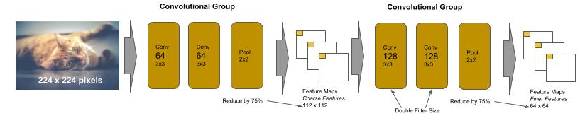
VGG
VGG Networks
The VGG type of CNN was designed by the Visual Geometry Group at Oxford. It was designed to compete in the international ImageNet competition for image recognition for 1000 classes of images. The VGGNet in the 2014 contest took first place on image location task and second place on the image classification task.
It is designed using a handful of principles that are easy to learn. The convolutional frontend consists of a sequence of pairs (and later triples) of convolutions of the same size, followed by a max pooling. The max pooling layer downsamples the generated feature maps by 75% and the next pair (or triple) of convolutional layers than doubles the number of learned filters. The principle behind the convolution design was that the early layers learn coarse features and subsequent layers, by increasing the filters, learn finer and finer features, and the max pooling is used between the layers to minimize growth in size (and subsequently parameters to learn) of the feature maps. Finally, the DNN backend consists of two identical sized dense hidden layers of 4096 nodes each, and a final dense output layer of 1000 nodes for classification.

Slide 41
VGG16
VGG16 - Sequential Flow We will code a VGG16 in two coding styles. The first in a sequential flow.
from keras import Sequential from keras.layers import Conv2D, MaxPooling2D, Flatten, Dense model = Sequential() # First convolutional block model.add(Conv2D(64, (3, 3), strides=(1, 1), padding="same", activation="relu", input_shape=(224, 224, 3))) model.add(Conv2D(64, (3, 3), strides=(1, 1), padding="same", activation="relu")) model.add(MaxPooling2D((2, 2), strides=(2, 2))) # reduce feature maps by 75% # Second convolutional block - double the number of filters model.add(Conv2D(128, (3, 3), strides=(1, 1), padding="same", activation="relu")) model.add(Conv2D(128, (3, 3), strides=(1, 1), padding="same", activation="relu")) model.add(MaxPooling2D((2, 2), strides=(2, 2))) # reduce feature maps by 75% ### REMOVED Lines for Brevity # DNN Backend model.add(Flatten()) model.add(Dense(4096, activation='relu')) model.add(Dense(4096, activation='relu')) # ...

Slide 42
VGG16
VGG16 - Procedurally (Reuse)
Let’s now code the same using a procedural “reuse” style. In this example we created a procedure (function) call conv_block() which builds the convolutional blocks, and takes as parameters the number of layers in the block (2 or 3), and number of filters (64, 128, 256 or 512). Note that we kept the first convolutional layer outside of the conv_block. The first layer needs the input_shape parameter. We could have coded this as a flag to conv_block, but since it would only occur one time, then it’s not reuse. So we inline it instead.
from keras import Sequential from keras.layers import Conv2D, MaxPooling2D, Flatten, Dense def conv_block(n_layers, n_filters): for n in range(n_layers): model.add(Conv2D(n_filters, (3, 3), strides=(1, 1), padding="same", activation="relu")) model.add(MaxPooling2D(2, strides=2)) # Convolutional Frontend model = Sequential() model.add(Conv2D(64, (3, 3), strides=(1, 1), padding="same", activation="relu", input_shape=(224, 224, 3))) conv_block(1, 64) conv_block(2, 128) conv_block(3, 256) conv_block(3, 512) conv_block(3, 512) # ...

Slide 43
Residual Convolutional Networks (ResNet)
ResNet Networks
The ResNet type of CNN was designed by Microsoft Research. It was designed to compete in the international ImageNet competition. The ResNet in the 2015 contest took first place in all categories for ImageNet and COCO competition.
ResNet, and other architectures within this class, use different layer to layer connection patterns. The pattern we’ve discussed so far (ConvNet and VGG) use the fully connected layer to layer pattern.
ResNet 34 introduced a new block layer and layer connection pattern, residual blocks and identity connection, respectively.
The residual block in ResNet 34 consists of blocks of two identical convolutional layers without a pooling layer.
Each block has an identity connection which creates a parallel path between the input of the residual block and its output.
Like VGG, each successive block doubles the number of filters. Pooling is done at the end of the sequence of blocks.

Slide 44
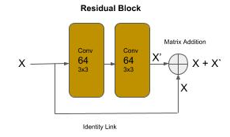
Residual Convolutional Networks (ResNet)
ResNet Networks
One of the problems with neural networks is that as we add deeper layers (under the presumption of increasing accuracy) their performance can degrade. That is, it can get worse not better.
Residual blocks allow neural networks to be built with deeper layers without a degradation in performance.

Slide 45
ResNet - Residual Block
Residual Blocks
Below is shows how a residual block can be coded in Keras using the Sequential method approach. The variable x represents the output of a layer, which is the input to the next layer. At the beginning of the block, we retain a copy of the previous block/layer output as the variable shortcut. We then pass the previous block/layer output (x) through two convolutional layers, each time taking the output from the previous layer as input into the next layer. Finally, the last output from the block (retained in the variable x) is added (matrix addition) with the original value of x (shortcut). This is the identity link.
shortcut = x x = layers.Conv2D(64, kernel_size=(3, 3), strides=(1, 1), padding='same')(x) x = layers.ReLU()(x) x = layers.Conv2D(64, kernel_size=(3, 3), strides=(1, 1), padding='same')(x) x = layers.ReLU()(x) x = layers.add([shortcut, x])

Slide 46
ResNet - Convolutional Block Connector
Convolutional Block Connector
Unlike VGG though, there is no pooling layer between the groups that would reduce the size of the feature maps. Now, if we connected these blocks directly with each other, we have a problem. That is, the input to the next block has the shape based on the previous block’s filter size (let’s call it X). The next block by doubling the filters will cause the output of that residual block to be double in size (let’s call it 2X). The identity link would attempt to add the input matrix (X) and the output matrix (2X). Yeaks, we get an error, indicating we can’t broadcast (for add operation) matrices of different sizes.
For ResNet, this is solved by adding a convolutional block between each “doubling” group of residual blocks. The convolutional block doubles the filters to reshape the size and doubles the stride to reduce the size by 75%.
# First Residual Block Group of 64 filters for _ in range(3): x = residual_block(64, x) # Double the size of filters and reduce feature maps by 75% (strides=2, 2) to fit the next Residual Group x = conv_block(128, x)

Slide 47
ResNet - ReUse Procedures
Residual and Convolutional Blocks as Reuse Procedures
def residual_block(n_filters, x): """ Create a Residual Block of Convolutions n_filters: number of filters x : input into the block """ shortcut = x x = layers.Conv2D(n_filters, (3, 3), strides=(1, 1), padding="same", activation="relu")(x) x = layers.Conv2D(n_filters, (3, 3), strides=(1, 1), padding="same", activation="relu")(x) x = layers.add([shortcut, x]) return x def conv_block(n_filters, x): """ Create Block of Convolutions without Pooling n_filters: number of filters x : input into the block """ x = layers.Conv2D(n_filters, (3, 3), strides=(2, 2), padding="same", activation="relu")(x) x = layers.Conv2D(n_filters, (3, 3), strides=(2, 2), padding="same", activation="relu")(x) return x

Slide 48
ResNet - Pooling/Flattening
Global Average Pooling
The output of the last residual block group is passed to a pooling and flattening layer (GlobalAveragePooling2D), which is then passed to a single Dense layer of 1000 nodes (number of classes).
In modern convolutional architectures, the DNN backend is now a single dense layer for the final classification. In other words, except for the last step of predicting the class (label), classification is now pushed to the frontend in the last convolutional blocks.
# Now Pool at the end of all the convolutional residual blocks x = layers.GlobalAveragePooling2D()(x) # Final Dense Outputting Layer for 1000 outputs outputs = layers.Dense(1000)(x) model = Model(inputs, outputs)

Slide 49
ResNet - Computational Faster
Computational Complexity
Let’s now run model.summary(). We see that the total number of parameters to learn is 21 million. This is in contrast of the VGG16 which has 138 million parameters. So the ResNet architecture is 6 times computationally faster. This reduction is mostly achieved by the construction of the residual blocks. Notice how the DNN backend is just a single output Dense layer. In effect, there is no backend. The top residual block groups act as the CNN frontend doing the feature detection, while the bottom residual blocks perform the classification. In doing so, unlike VGG, there was no need for several fully connected dense layers, which would have substantially increased the number of parameters.
Another advantage is the identity link, which provided the ability to add deeper layers, without degradation, for higher accuracy.

Slide 50
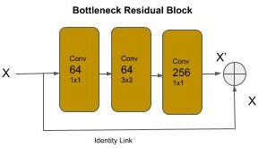
ResNet50 - Bottleneck Residual Block
Bottleneck Residual Block
ResNet50 introduced a variation of the residual block referred to as the bottleneck residual block. In this version, the group of two 3x3 convolution layers are replaced by a group of 1x1, then 3x3, and then 1x1 convolution layer. The 1x1 convolutions perform a dimension reduction reducing the computational complexity, and the last convolutional restores the dimensionality increasing the number of filters by a factor of 4. The bottleneck residual group allows for deeper neural networks, without degradation, and further reduction in computational complexity.

Slide 51
ResNet50 - Bottleneck Residual Block
Bottleneck Residual Block
Below is a code snippet for writing a bottleneck block as a reusable function:
def bottleneck_block(n_filters, x): """ Create a Bottleneck Residual Block of Convolutions n_filters: number of filters x : input into the block """ shortcut = x x = layers.Conv2D(n_filters, (1, 1), strides=(1, 1), padding="same", activation="relu")(x) x = layers.Conv2D(n_filters, (3, 3), strides=(1, 1), padding="same", activation="relu")(x) x = layers.Conv2D(n_filters * 4, (1, 1), strides=(1, 1), padding="same", activation="relu")(x) x = layers.add([shortcut, x]) return x

Slide 52
Batch Normalization
Batch Normalization
Another problem with adding deeper layers in a neural network is the vanishing gradient problem. This is actually about the computer hardware. During training (process of backward propagation and gradient descent), at each layer the weights are being multiplied by very small numbers, specifically numbers less than 1. As you know, two numbers less than one multiplied together make an even smaller number. When these tiny values are propagated through deeper layers they continuously get smaller. At some point, the computer hardware can’t represent the value anymore - and hence, the vanishing gradient.
The problem is further exacerbated if we try to use half precision floats (16 bit float) for the matrix operations versus single precision (32 bit float). The advantage of the former is that the weights (and data) are stored in half the amount of space and using a general rule of thumb by reducing the computational size in half, we can execute 4 times as many instructions per compute cycle. The problem of course is that with even smaller precision, we will encounter the vanishing gradient even sooner.

Slide 53
Batch Normalization
Batch Normalization
Batch normalization is a technique applied to the output of a layer (before or after the activation function).It normalizes the shift in the weights as they are being trained. This has several advantages, it smoothes out (across a batch) the amount of change, thus slowing down the possibility of getting a number so small that it can’t be represented by the hardware. Additionally, by narrowing the amount of shift between the weights, convergence can happen sooner using a higher learning rate and reducing the overall amount of training time. Batch normalization is added to a layer in Keras with the BatchNormalization() class.
from keras import Sequential from keras.layers import Conv2D, ReLU, BatchNormalization, Flatten, Dense model = Sequential() model.add(Conv2D(64, (3, 3), strides=(1, 1), padding='same', input_shape=(128, 128, 3))) # Add a batch normalization (when training) to the output before the activation function model.add(BatchNormalization()) model.add(ReLU()) model.add(Flatten()) model.add(Dense(4096)) model.add(ReLU()) # Add a batch normalization (when training) to the output after the activation function model.add(BatchNormalization())

Slide 54
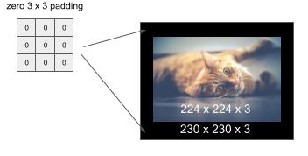
Pre-Stems - Zero Padding
Pre-Stems - Zero Padding
We fix this problem by adding padding around the input shape to match the input shape that the neural network architecture was optimized and/or trained for. In our example, we need to extend the 224 x 224 to 230 x 230. We can do this by adding a 3 x 3 pad (of zero values) around the image, as shown below:

Slide 55
Advanced - Pre-Stems - Zero Padding
Pre-Stems - Zero Padding
The code below demonstrates using the ZeroPadding2D() method for adding a pad, where the parameter (3, 3) specifies the height and width of the pad to place around the image.
from keras import layers, Input # not the input shape expected by the stem (which is (230, 230, 3) inputs = Input(shape=(224, 224, 3)) # pre-stem inputs = layers.ZeroPadding2D((3, 3))(inputs) # this will output: (230, 230, 3) print(inputs.shape) # this stem's expected shape is (230, 230, 3) x = layers.Conv2D(64, (7, 7), strides=(2,2))(inputs) X = layers.BatchNormalization()(x) x = layers.ReLU()(x) # this will output: (?, 112, 112, 64) print(x.shape)

Slide 56
Representational Equivalence
Representational Equivalence and Factorization
Factorization is decomposing a first block structure into smaller components which are representationally equivalent. The term representational equivalence means that the replaced design will maintain the same accuracy during training.
The goal of the factorization is to replace one design with another that is representationally equivalent but its computational complexity is less. The result is a smaller model to train, as measured by the number of weights, but retains the same accuracy.
The architectures for ResNeXt and for later versions of Inception relied on factorization. Typically, these factorizations are inferred through computational theory and then proved empirically.

Slide 57
Computer Vision - Data Engineering
Part 5 : Data Assembly
Part 6 : Data Engineering
Part 7 : Data Augmentation
Part 8 : Data Curation

Slide 58
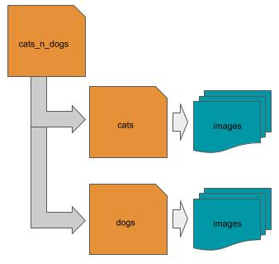
Dataset Layout - Directory Structure
Dataset as a Directory Structure
Laying out (placing) the images into a directory folder structure on a local disk is one of the most common layouts. In this layout, the root (parent) folder is a container for the dataset. Below the root level are one or more subdirectories, where each subdirectory corresponds to a class (label), and where each subdirectory contains the images that correspond to that class. Using our cats and dogs example, one would have a parent directory that might be named ‘cats_n_dogs’, with two subdirectories, one named ‘cats’ and the other ‘dogs’. Within each subdirectory would be the corresponding class of images.
.

Slide 59
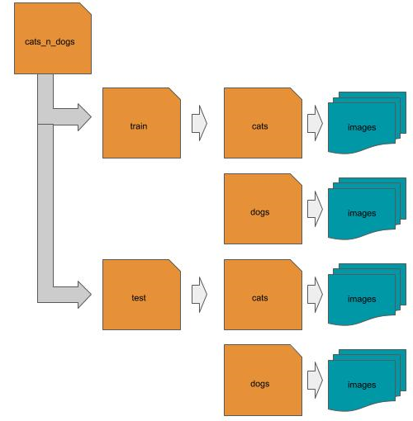
Dataset Layout - Directory Structure
Train and Test Directory Structure
Alternatively, if the dataset has been pre-split into training and test data, explained subsequently, then the split images for each class (label) are placed under the corresponding subfolders train and test, which are then underneath (subfolder of) the root folder of the dataset.

Slide 60
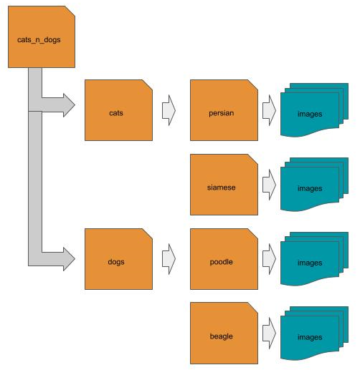
Dataset Layout - Directory Structure
Hierarchical Directory Structure
Alternatively, if the dataset has been pre-split into training and test data, explained subsequently, then the split images for each class (label) are placed under the corresponding subfolders train and test, which are then underneath (subfolder of) the root folder of the dataset.

Slide 61
Dataset Layout - CSV File
CSV File
Another common layout is to use a CSV file to identify the location and class (label) of each image. In this case, each row in the CSV file is a separate image, and the CSV file contains at least two columns, one for the location of the image, and the other for the class (label) of the image. The location might be either a local path, a remote location, or the pixel data is embedded as the value of the location.
local path example: remote path example:
label,location label, location ‘cat’, cats_n_dogs/cat/1.jpg ‘cat’,’http://mysite.com/cats_n_dogs/cat/1.jpg’ ‘dog’,cats_n_dogs/dog/2.jpg ‘dog’,’http://mysite.com/cats_n_dogs/dog/2.jpg’ … ...
embedded data example:
Label,location ‘cat’,[[...],[...],[...]] ‘dog’,[[...], [...], [...]]

Slide 62
Dataset Layout - JSON File
JSON File
Another common layout is to use a JSON file to identify the location and class (label) of each image. In this case, the JSON file is an array of objects, where each object is a separate image, and each object has at least two keys, one for the location of the image, and the other for the class (label) of the image.The location might be either a local path, a remote location, or the pixel data is embedded as the value of the location.
local path example:
[ {‘label’: ‘cat’, ‘location’: ‘cats_n_dogs/cat/1.jpg’ }, {‘label’: ‘dog’, ‘location’: ‘cats_n_dogs/dog/2.jpg’} … ]

Slide 63
Dataset Layout - HDF5 File
HDF5 File
Another common layout and storage format is to use a HDF5 (hierarchical data format) format file, which are very efficient for storing and accessing large amounts of multi-dimensional data, such as images. The format supports dataset and group objects, as well as attributes (metadata) per object. Typically, the file will consist of a group object per class (label), and each group will consist of one or more dataset objects for the corresponding images. Additional information, such as the label name, are stored as group attributes.
Group Attribute: {label: cats} Dataset: [...]
Group Attribute: {label: dogs} Dataset

Slide 64
Dataset Layout - HDF5 Hierarchical Storage
HDF5 Hierarchical Storage
The format supports hierarchical storage of groups. If the images are hierarchically labeled, then each group is further partitioned into a hierarchy of subgroups.
Group Attribute: {label: cats} Group: Attribute: {label: persian} Dataset: [...] Group: Attribute: {label: siamese} Dataset: [...]
Group Attribute: {name: dogs} Group: Attribute: {label: poodle} Dataset: [...] Group: Attribute: {label: beagle} Dataset: [...]

Slide 65
Dataset Layout - In Memory
In Memory
An image dataset may already be in memory. This is typical for curated datasets provided by ML frameworks (like Keras) for educational purposes. In this case, the image dataset has been prepared into machine learning ready data, and pre-split into train and test, with the label data already one-hot encoded (discussed later in this part).
Image 1 Image 2 Image 3 Image 4 Image 5 X_train = [ [ [...],[...],[...]], [ [...],[...],[...]], [ [...],[...],[...]], [ [...],[...],[...]], [ [...],[...],[...]], … ] Y_train = [ [... 1 …] [… 1 …], [… 1 …], [... 1 …], [... 1 …], … ]

Slide 66
Data Engineering
Data Engineering
You can’t just drop images into a neural network and expect it to learn (recognize) what the images are.
There are some preprocessing steps that need to be done with an image dataset, which is referred to as data engineering. These include:
Loading (reading) in the images as raw pixel data.
Fitting them to the input vector of the neural network which will be used for training.
Conversion of the pixel data.
Splitting the dataset
In the following sections, we will cover the different ways to perform these steps in openCV and Keras library modules.

Slide 67
OpenCV Library
OpenCV Library
OpenCV is an open source image manipulation library that is implemented in a wide variety of programming languages, including Python. It has been around a long-time and widely supported and updated by the open source community. It has been the conventional work-horse of imaging scientists.
Everything we did in PIL, we will show in this section how to do in OpenCV.
One can install OpenCV with pip install opencv-python.

Slide 68
OpenCV Reading Images
OpenCV Reading Images
An image is read into memory using the cv2.imread() method. One of the first advantages I find with the cv2.imread() method is the output is already in a multi-dimensional numpy data type.
By default, cv2.imread() will convert the image to a three channel RGB image.
import cv2 image = cv2.imread('myimage.jpg')

Slide 69
OpenCV Channel Conversion
OpenCV Channel Conversion
Another advantage of OpenCV over PIL is that you can do the channel conversion at the time of reading in the image, instead of a second step. You can specify a second parameter that indicates which channel conversion to use. In the example below, we show doing the channel conversion at the time the image is read in.
# read in image as a single channel (grayscale) image if channel == 1: image = cv2.imread('myimage.jpg', cv2.IMREAD_GRAYSCALE) # read in image as a three channel (color) image else: image = cv2.imread('myimage.jpg', cv2.IMREAD_COLOR)

Slide 70
OpenCV Reading Image - Remote
OpenCV Reading Image from Remote Location
In the example below, we show reading in the image from a remote location (url) and doing the channel conversion at the same time. In this case, we use the method cv2.imdecode():
try: response = requests.get(url) if channel == 1: return cv2.imdecode(BytesIO(response.content), cv2.IMREAD_GRAYSCALE) else: return cv2.imdecode(BytesIO(response.content), cv2.IMREAD_COLOR) except: return None

Slide 71
OpenCV Resizing Image
OpenCV Resizing
Images are resized using the cv2.resize() method. The second parameter is a tuple of the height and width to resize the image to. The optional (keyword) third parameter is the interpolation algorithm to use when resizing. Since in most cases you will be downsampling, the common practice is to use the cv2.INTER_AREA algorithm for best results in preserving information and minimizing artifacts when downsampling an image.):
# resize an image to 128 (height) x 128 (width) image = cv2.resize(image, (128, 128), interpolation=cv2.INTER_AREA)

Slide 72
OpenCV LoadImages()
Rewrite LoadImages() using OpenCV
Let’s write the loadImages() function using OpenCV.
def loadImages(subdir, channels, shape): images = [] # get list of all files in subdirectory cats files = os.scandir(subdir) # read each image in and append the in-memory image to a list for file in files: # convert to grayscale if channels == 1: image = cv2.imread(file.path, cv2.IMREAD_GRAYSCALE) # convert to RGB color else: image = cv2.imread(file.path, cv2.IMREAD_COLOR) # resize the image to the target input shape images.append(cv2.resize(image, shape, cv2.INTER_AREA)) return np.asarray(images) loadImages('cats', 3, (128, 128)), cv2.INTER_AREA)

Slide 73
Normalization (Standardization)
Normalization and Data Type
At this point, all the image data is in a numpy multidimensional array. As a final step, we want to perform :
normalization (or standardization) on the pixel data, and
fit the pixel data to a data type size.
The process makes all the images have a similar pixel value distribution, which leads to faster convergence when training a neural network. This means less epochs (or steps), which means less total compute time.
Normalization will squash all the pixel values in a range between 0 and 1, or between -1 and 1, while standardization will squash the pixel values into a distribution with a mean centered at 0 and one standard deviation.

Slide 74
Normalization
Normalization using Numpy
Images taken by a camera are almost universally 8 bits per pixel per channel format, represented as an unsigned 8 bit integer value (e.g., np.uint8). Therefore, we can do the squashing function by dividing each pixel value by 255. So a value 0 would become a 0, a value of 255 would become a 1, and all other values will be in-between.
The numpy library has overridden the division operator between two numpy arrays to perform a very fast array-wide matrix division. So we can do this operation as a single step.
# Normalization between 0 and 1 of 8 bits per pixel per channel images = images / 255.0

Slide 75
Normalization - High Dynamic Range
Normalization of High Dynamic Range Images (16bpp/channel)
In some image datasets, the images may be in a different bits per pixel representation. For example, 16 bits per pixel per channel for high color images, which have a dynamic color range between 0 .. 65535 vs 0 .. 255 for 8 bits per pixel. When normalizing between 0 and 1, we need to divide by the maximum value of the pixel range.
if images.itemsize == 1: images = images / 255.0 # Normalization between 0 and 1 of 16 bits per pixel per channel elif images.itemsize == 2: images = images / 65535.0

Slide 76
Normalization - Center at Zero
Normalization between 0 and 1
When normalizing, some prefer to normalize between -1 and 1, to center the pixel values around 0.
if images.itemsize == 1: images = images / 127.5 - 1 elif images.itemsize == 2: images = images / 32767.5 - 1

Slide 77
Standardization
Standardization
Another method of squashing pixel values into a similar distribution is called standardization. In this method, a mean and a standard deviation are calculated across all the pixel values. Then the mean is centered at zero and each pixel divided by a standard deviation of 1. This takes more computation than normalization.
If your images are a fairly basic and fairly consistent distribution of pixel values, then a normalization is sufficient. For example, in the MNIST dataset, all the digits are in a narrow grayscale range and all the backgrounds are the same. For this case, normalization is sufficient. When your working though with color images, the distribution of pixel values can be very diverse across images. In general, normalization is used with grayscale images and standardization with color images.

Slide 78
Standardization
Standardization
To prevent a division by zero in the case where the standard deviation is zero, it is a common practice to add a tiny amount, referred to as an epsilon, so the denominator will never be zero.
# standardization across all pixels/channels e = 1e-7 # epison, add a tiny amount to standard deviation to prevent divide by 0. images = (images - np.mean(images)) / (np.std(images) + e) - 1

Slide 79
Data Types
Floating Point Size
The last step is setting the data type of the normalized (or standardized) pixel data. At this point the pixel data values are floating point numbers, and generally very small numbers (e.g., between 0.0 and 1.0). By default, numpy will represent floating point values as double precision floats (float64). That’s 8 bytes per float, which is 8 bytes per pixel per channel. Let’s assume the input shape to the neural network is (128, 128, 3). That will require 50K pixels per image, and at 8 bytes per pixel per channel, that’s 400K bytes per image. At 10,000 images, that will require 4GB of memory to hold them all at once in memory.
Neural networks work well with lower float precision. Single precision float (float32) is the common practice, which takes ½ the space and ¼ the number of floating point instructions per cycle.
# set the data type images = images.astype(np.float32) # now do the standardization images = (images - np.mean(images)) - np.std(images)

Slide 80
Keras Image Preprocessing
Keras Image Preprocessing
Keras provides image preprocessing functions for both in-memory (i.e., numpy arrays) and on-disk images with the class ImageDataGenerator. This class combines data preprocessing, data feeding and data augmentation in a single step. I find whether you do your data preprocessing, as well as augmentation and feeding, outside of Keras functions or all-in-one is a personal preference.
For those wanting the fine level control of the data for functionality and the bare-metal programming for speed, I recommend the ‘manual’ approach of using openCV.
For those seeking an easy encapsulation of the steps, I would recommend the methods builtin to Keras.

Slide 81
ImageDataGenerator
Data Feeder - ImageDataGenerator
The ImageDataGenerator class creates a generator for feeding batches into a neural network during training. For our purpose here, I will only cover the preprocessing functions. The subset of parameters in ImageDataGenerator for preprocessing are:
rescale / dtype
featurewise_center / featurewise_std_normalization
samplewise_center / samplewise_std_normalization
zca_whitening / zca_epsilon
The image preprocessing using ImageDataGenerator is a two-step process:
Specify normalization / standardization in the instantiation of the ImageDataGenerator object.
The images are presumed to either:
be in memory as numpy tensors and already resized (flow() method), or
are resized when feeding from disk using the flow_from_directory() method.

Slide 82
ImageDataGenerator - Normalization
Normalization with ImageDataGenerator
In this code example, we instantiate the ImageDataGenerator to do a normalization of the pixel data by squashing the values between 0 and 1, and then perform the normalization by invoking the fit() method of the training data (x_train).
from keras.preprocessing.image import ImageDataGenerator # specify normalizing the pixel data between 0 and 1 (for 8 bits per pixel/per channel) datagen = ImageDataGenerator(rescale=1/255.0) # normalize the pixels pixels in the training data datagen.fit(x_train)

Slide 83
ImageDataGenerator - Normalization
Standardization with ImageDataGenerator
Alternately, we can normalize the pixel data by centering it around the mean (i.e., per channel mean) by setting the featurewise_center to True.
Additionally, we can specify to do standardization of both centering the pixel data around the mean (i.e., per channel) and squashing the values to +/- one standard deviation by setting featurewise_std_normalization to True.
# specify normalizing the pixel data by centering them around a mean of 0 datagen = ImageDataGenerator(featurewise_center=True)
# specify normalizing the pixel data by centering them around a mean of 0 and # squashing the values within +/- one standard deviation datagen = ImageDataGenerator(featurewise_std_normalization=True)

Slide 84
ImageDataGenerator - Data Type
Setting Data Type with ImageDataGenerator
The data type of the pixel data, after optional normalization or standardization, by default with be a double precision float (FLOAT64). The parameter dtype when specified, will cast the pixel data to the corresponding data type, which is specified as a numpy data type (e.g., np.float32 for FLOAT32).

Slide 85
flow_from_directory() - Resizing
flow_from_directory() Method - Resizing
When feeding data during training to a Keras model, the data is either feed from in-memory or on-disk. When feeding in-memory using the flow() method, you must resize the images prior to feeding the neural network, such as the methods we described using PIL or OpenCV.
When you feed from on-disk using the flow_from_directory(), your set the parameter target_size to the height x width (HxW) of the input vector to the neural network.
# Create generator for feeding neural network from on-disk, and resize images to 128 x 128 as being feed feeder = datagen.flow_from_directory('root_of_dataset', target_size=(128, 128)) # Train the neural network by calling the fit_generator() method with the above feeder model.fit_generator(feeder, steps_per_epoch=steps, epochs=epochs)

Slide 86
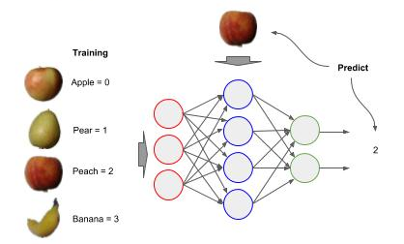
Label Encoding
Label Encoding
We need to keep track of which label (class) goes with each image. For each class (e.g., apple, pear, peach, banana, etc - Fruits360) we assign a unique integer value, starting with 0 to represent the class (remember everything in a neural network is a number - even the labels). When we train a neural network, the label will be the integer value we assigned to the class (y) and when predicting the neural network will output the integer value of the class it predicts (ŷ , aka. y-hat).

Slide 87
Label Encoding
Build a List of Labels corresponding to the Images
In the previous loadDirectory() example, the list dataset has an entry for each class of images processed, and the length of the entry is the number of images. In the code below we build a parallel list for the corresponding labels, with the same number of entries, and same length per entry as the dataset (processed images).
In the above, we set the data type of the labels to np.uint16, which is a 16-bit integer which can hold up to 65,535, to conserve space. If you have more than 65,535 classes, then you will want to set the data type as np.uint32.
dataset, classes = loadDirectory('fruits') # construct a corresponding labels list for ix, images in enumerate(dataset): # The labels have the same indices as the images (that's the label) label = np.asarray([ix] * len(images)).astype(np.uint16) labels.append(label)

Slide 88
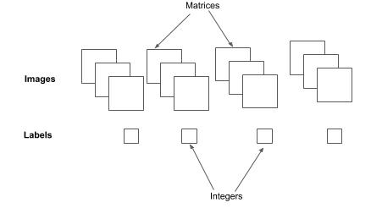
Label Encoding
Labels and Images as Multi-Dimensional Numpy Arrays
Next, we want both the list of processed images (machine learning ready data) and list of labels to each be a single long contiguous array. We use the np.concatenate() method to concatenate each element sequentially in a list into a single contiguous multidimensional numpy array.
# Convert list of Images and Labels to a contiguous numpy multidimensional array dataset = np.concatenate(dataset) labels = np.concatenate(labels)

Slide 89
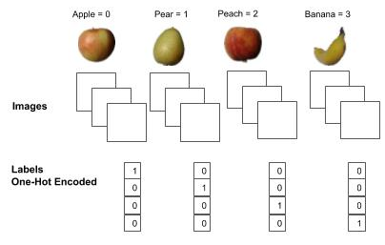
One Hot Encoding of Labels
One Hot Encoding of Labels
The final preparation step for the labels is to one-hot encode them to match the output vector of the neural network. The neural network will have an output node per class. For each label (e.g., 2), a one value is placed at the index location in the output vector that corresponds to the node for that label, and the remaining entries have the value 0.

Slide 90
One-Hot Encoding in Keras
One Hot Encoding of Labels in Keras
The Keras framework has a builtin method to_categorical() to automatically do one-hot encoding of labels.
from keras.utils import to_categorical # one-hot encode the labels labels = to_categorical(labels, len(classes))

Slide 91
Dataset Splitting
Splitting into Train and Test
When training a neural network for computer vision, one splits the processed image dataset into training data and test data, also referred to as the holdout set. That is, a portion of the processed image dataset is set aside to test the accuracy of the trained model, and is not used as part of the training. Generally only a small percentage should be set aside, and the larger the image dataset, the smaller that percentage can be. Below is a general rule of thumb of the percentage to set aside for test data, based on the number of images in the dataset:
< 1000 20% <10000 10%
>10000 5%

Slide 92
Dataset Shuffling
Shuffle and then Split
Prior to splitting the image dataset, we will want to randomly shuffle it. Why? Let’s presume that when building the dataset that all the images were sequenced by class. For example, all the apples come first, followed by pears, followed by peaches, and then by bananas. If we split this as 75% train and 25% test without shuffling, all the apples, pears and peaches will be in the training set and the bananas in the test set. The model won’t learn to recognize bananas, since they are not in the training set, and the test set will attempt to test for a class that the model hasn’t been trained on.

Slide 93
Dataset Splitting - Scikit-Learn
Dataset Splitting with Scikit-Learn
One can automatically shuffle and split a processed image dataset and labels using the scikit-learn function train_test_split().
from sklearn.model_selection import train_test_split # Split the processed image dataset into training and test data X_train, X_test, Y_train, Y_test = train_test_split(dataset, labels, test_size=0.20, shuffle=True)

Slide 94
Dataset Splitting - Keras
Dataset Splitting with Keras
As an alternative if the dataset is to be fed from on-disk (vs. in-memory), one can automatically shuffle and split the dataset and labels using Kera’s ImageDataGenerator method flow_from_directory().
# Create data generator where images will be normalized between 0 and 1, and # split the dataset between training and validation (10%). datagen = ImageDataGenerator(rescale=1/255.0, validation_split=0.1) # Create a generator to feed the model during training generator = datagen.flow_from_directory(dataset_directory, target_size=(128, 128), batch_size=32, shuffle=True) # train the model model.fit_generator(generator, epochs=50)

Slide 95
Image Augmentation
Image Augmentation
Image augmentation is the process of generating new images from existing images to improve the balance and/or variance in the training data. It is typically used to address:
Label(s) which have too few images.
Insufficient variance in [view] perspective.
Insufficient variance in lighting.
Image augmentation uses imaging algorithms which will modify an existing image without changing what the image is. That is, when a person views the modified image they will still see the same thing.

Slide 96
Image Augmentation - Perspective
Image Augmentation - Perspective Change
In general practice, the augmentation method that contributes the most to increasing the accuracy of a neural network are changes in the perspective. The methods, also referred to as transformations, are:
Flip
Rotation
Zoom
Shift

Slide 97
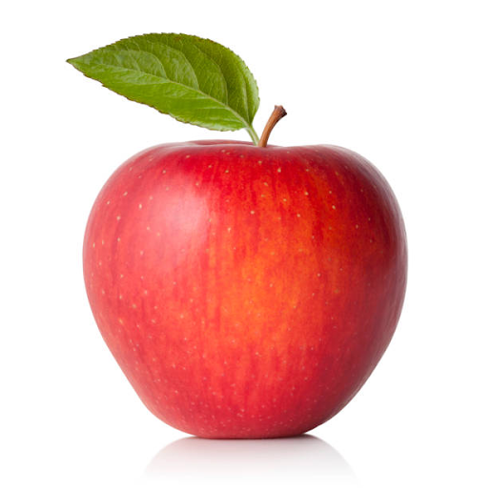
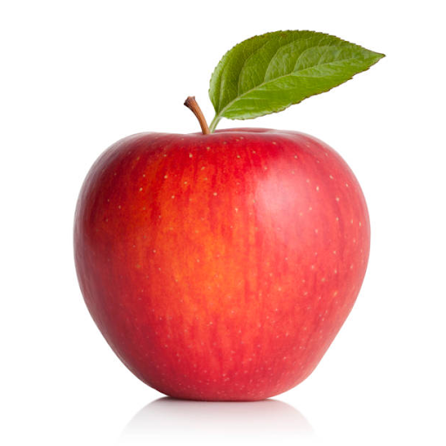
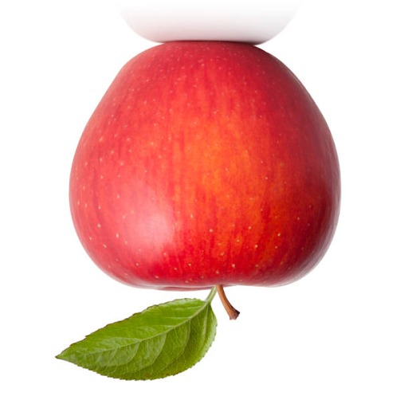
Image Augmentation - Flip
Image Augmentation - Flip
Flip transforms an image by flipping an image either on the vertical or horizontal axis. Since the image data is represented as a stack of 2D matrices (i.e., one per channel), A flip can be done efficiently as a matrix transpose function without changes (e.g., interpolation) of the pixel data.
Original Vertical Flip Horizontal Flip

Slide 98
Image Augmentation - Flip using OpenCV
Image Augmentation - Flip with OpenCV
The code example below demonstrates how to flip an image vertically (mirror) and horizontally using a matrix transpose method in OpenCV:
import cv2 from matplotlib import pyplot as plt # read in the image image = cv2.imread('apple.jpg') # display the image in its original perspective plt.imshow(image) # flip the image on the vertical axis (mirror) flip = cv2.flip(image, 1) plt.imshow(flip) # flip the image on the horizontal axis (upside down) flip = cv2.flip(image, 0) plt.imshow(flip)

Slide 99
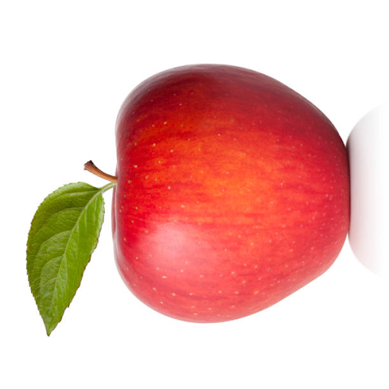
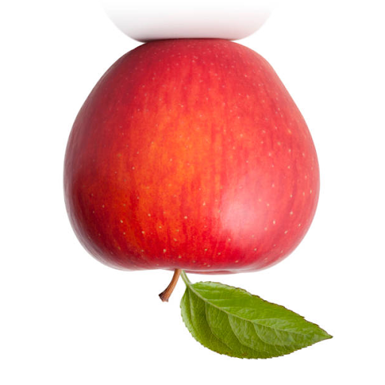
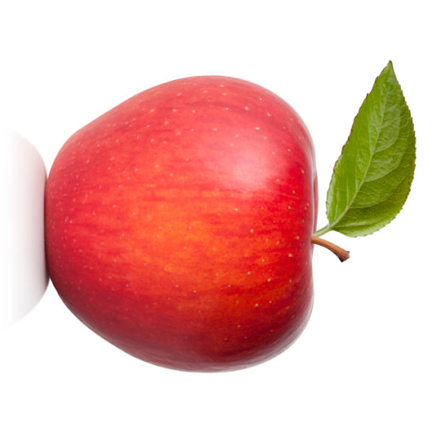
Image Augmentation - Rotation 90
Image Augmentation - Rotate 90 (right), 180 (upside down), 270 (left) degrees
In addition to flips, a matrix transpose operation can be used to rotate an image 90 degrees (left), 180 degrees, and 270 degrees (right). Like a flip, the operation is very efficient, and does not require interpolation of pixels and does not have a side effect of clipping.
90 180 270

Slide 100
Image Augmentation - Rotation 90 / Numpy
Image Augmentation - Rotation 90 with Numpy
The code example below demonstrates how to rotate an image 90, 180 and 270 degrees using the numpy method rot90(), where the first parameter is the image to rotate 90 degrees and the second parameter (k) is the number of times to perform the rotation:
# read in the image image = cv2.imread('apple.jpg') # rotate the image 90 degrees rotate = np.rot90(image, 1) plt.imshow(rotate) # rotate the image 180 degrees rotate = np.rot90(image, 2) plt.imshow(rotate) # rotate the image 270 degrees rotate = np.rot90(image, 3) plt.imshow(rotate)

Slide 101
Image Augmentation - Rotation
Image Augmentation - Rotation
A rotation transforms an image by rotating the image within -180 and 180 degrees. Generally, the degree of rotation is randomly selected. You may also want to limit the range of rotation to match the environment the model will be deployed in. Below are some common practices:
If the images will be dead-on, use -15 to 15 degree range.
If the images may be on an incline, use -30 to 30 degree range.
For small objects, like packages, money, use the full range of -180 to 180.
Another issue with rotation, is that if you rotate an image within the same size boundaries, other than 90, 180, or 270, a portion of the edge of the image will end up outside the boundary (i.e., clipped).

Slide 102
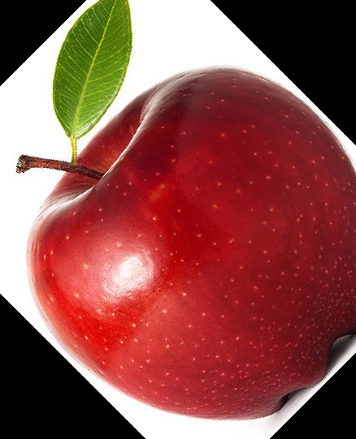
Image Augmentation - Rotation
Image Augmentation - Rotation
Below is an example of using PIL method rotate() to rotate the image of the apple 45 degrees. You can see part of the bottom of the apple and the stem are clipped.

Slide 103
Image Augmentation - Rotation
Image Augmentation - Rotation w/o Clipping (OpenCV)
The correct way to handle a rotation is to rotate it within a larger bounding area, such that none of the image is clipped, and then resize the rotated image back to the original size. For this purpose, I recommend using the imutils module (Adrian Rosebrock), which consists of a collection of convenience methods for openCV
import cv2, imutils from matplotlib import pyplot as plt # read in the image image = cv2.imread('apple.jpg') # remember the original Height and Width shape = (image.shape[0], image.shape[1]) # rotate the image rotate = imutils.rotate_bound(image, 45) # resize the image back to its original shape rotate = cv2.resize(rotate, shape, interpolation=cv2.INTER_AREA) plt.imshow(rotate)

Slide 104
Image Augmentation - Zoom / OpenCV
Image Augmentation - Zoom with OpenCV
When enlarging an image using cv2.resize() interpolation cv2.INTER_CUBIC generally provides the best results. The interpolation cv2.INTER_LINEAR is faster and provides nearly comparable results. The interpolation cv2.INTER_AREA is generally used when reducing an image.
import cv2 from matplotlib import pyplot as plt zoom = 2 # zoom by a factor of 2 # remember the original height, width of the image height, width = image.shape[:2] # find the center of the scaled image center = (image.shape[0]//2, image.shape[1]//2) z_height = int(height // zoom) z_width = int(width // zoom) # slice (cutout) the zoomed image by forming a crop bounding box image = image[(center[0] - z_height//2):(center[0] + z_height//2), center[1] - z_width//2:(center[1] + z_width//2)] # resize (enlarge) the cropped image back to the original size. image = cv2.resize(image, (width, height), interpolation=cv2.INTER_CUBIC) plt.imshow(image)

Slide 105
Image Augmentation - Shift / Numpy
Image Augmentation - Shift with Numpy
A shift will shift the pixel data in the image +/- in the vertical (height) or horizontal (width) axis. This will change the location in the image of the object being classified. The code below demonstrates shifting an image +/- 10% vertically and horizontally using the numpy np.roll() method.
import cv2 import numpy as np # read in the image image = cv2.imread('apple.jpg') # get the height and width of the image height = image.shape[0] Width = image.shape[1] # shift the image down by 10% roll = np.roll(image, height // 10, axis=0) # shift the image up by 10% roll = np.roll(image, -(height // 10), axis=0) # shift the image right by 10% roll = np.roll(image, width // 10, axis=1) # shift the image left by 10% roll = np.roll(image, -(width // 10), axis=1)

Slide 106
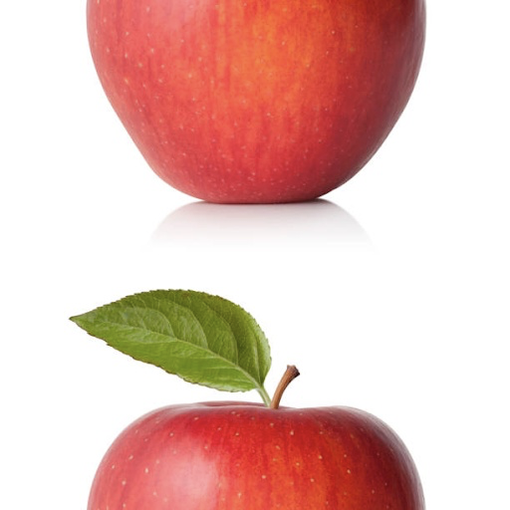
Image Augmentation - Fractured Shift
Image Augmentation - Fractured Shift
A shift is very efficient in that it is implemented as a roll operation of the matrix, where the rows (height) or columns (width) are shifted. As such, the pixels that are shifted off the end are added to the beginning. If the shift is too large, the image can become fractured into two pieces with each piece opposing each other.
Below is an example of where the apple was shifted by 50% vertically, leaving it fractured.
To avoid fracture, It is a general practice to limit the shift of the image to no more than 20%.

Slide 107
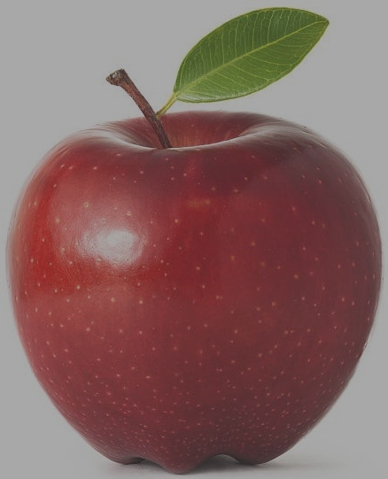
Image Augmentation - Lighting / OpenCV
Image Augmentation - Lighting / OpenCV
There are a number of techniques for changing lighting. For example:
Apply a uniform multiplier on each pixel.
Apply specific multiplier per channel on each pixel.
Apply specific multiplier per range of pixel values on each pixel.
The code below demonstrates using the OpenCV method convertScaleAbs(). This method applies a uniform multiplier across the pixels and a delta added to each value, specified by the parameters alpha and beta, respectively:
import cv2 image = cv2.imread('apple.jpg') contrast = 0.5 brightness = 40 # scale the pixel values and then convert back to uint8 image = cv2.convertScaleAbs(image, alpha=contrast, beta=brightness)

Slide 108
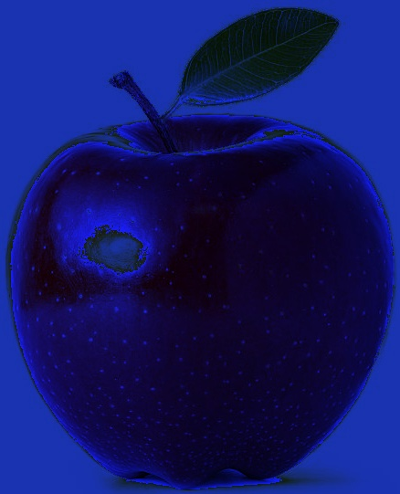
Image Augmentation - Lighting / OpenCV
Image Augmentation - Lighting / OpenCV
Below is an example of applying a multiplier per channel:
import cv2 import numpy as np from matplotlib import pyplot as plt image = cv2.imread('apple.jpg') # multiplier: Blue* 1.7, Green * 0.2, Red * 0.1 image = image * np.array([1.7, 0.2, 0.1]) image = image.astype(np.uint8) plt.imshow(image)

Slide 109
Image Augmentation in Keras
Image Augmentation in Keras
The Keras image preprocessing module supports a wide variety of image augmentation with the class ImageDataGenerator. The ImageDataGenerator class creates a generator for generating batches of augmented images. The class initializer takes as input zero or more parameters for specifying the type of augmentation. Below are a few of the parameters:
horizontal_flip=True
vertical_flip=True
rotation_range=degrees
zoom_range=(lower, upper)
width_shift_range=percent
height_shift_range=percent
brightness_range=(lower, upper)

Slide 110
Image Augmentation - Flip / Keras
Image Augmentation / Flip in Keras
In the next code example, we do the following:
Read in a single image of an apple.
Create batch of one image (the apple).
Instantiate an ImageDataGenerator object.
Initialize the ImageDataGenerator with our augmentation options (in this case: horizontal and vertical flip).
Use the flow() method of the ImageDataGenerator method to create a batch generator.
Iterate through the generator 6 times, each time returning a batch of 1 image in x.
The generator will randomly select an augmentation (including no augmentation) per iteration.
After transformation (augmentation), the pixel values will be 32-bit float.
Change the data type of the pixels back to 8-bit integer, for displaying using matplotlib.

Slide 111
Image Augmentation - Flip / Keras
Image Augmentation - Flip with Keras
from keras.preprocessing.image import ImageDataGenerator import cv2 import numpy as np from matplotlib import pyplot as plt # Let's make a batch of 1 image (apple) image = cv2.imread('apple.jpg') batch = np.asarray([image]) # Create a data generator for augmenting the data datagen = ImageDataGenerator(horizontal_flip=True, vertical_flip=True) # Let's run the generator, where every image is a random augmentation step=0 for x in datagen.flow(batch, batch_size=1): step += 1 if step > 6: break plt.figure() # the augmentation operation will change the pixel data to float # change it back to uint8 for displaying the image plt.imshow(x[0].astype(np.uint8))

Slide 112
Image Augmentation - Rotation / Keras
Image Augmentation - Rotation with Keras
In the code below, we use the rotation_range parameter to set random rotations between -60 and 60 degrees. Note, that rotate operation does not perform a bounds check and resize (like imutils.rotate_bound(), so part of the image may end up being clipped.
# Let's make a batch of 1 image (apple) image = cv2.imread('apple.jpg') batch = np.asarray([image]) # Create a data generator for augmenting the data datagen = ImageDataGenerator(rotation_range=60) # Let's run the generator, where every image is a random augmentation step=0 for x in datagen.flow(batch, batch_size=1): step += 1 if step > 6: break plt.figure() # the augmentation operation will change the pixel data to float # change it back to uint8 for displaying the image plt.imshow(x[0].astype(np.uint8))

Slide 113
Image Augmentation - Zoom / Keras
Image Augmentation - Zoom with Keras
In the code below, we use the zoom_range parameter to set random values between 0.5 (zoom out) and 2 (zoom in). Note that the value can be specified either as a tuple or list of two elements.
# Let's make a batch of 1 image (apple) image = cv2.imread('apple.jpg') batch = np.asarray([image]) # Create a data generator for augmenting the data datagen = ImageDataGenerator(zoom_range=(0.5, 2)) # Let's run the generator, where every image is a random augmentation step=0 for x in datagen.flow(batch, batch_size=1): step += 1 if step > 6: break plt.figure() # the augmentation operation will change the pixel data to float # change it back to uint8 for displaying the image plt.imshow(x[0].astype(np.uint8))

Slide 114
Image Augmentation - Shift / Keras
Image Augmentation - Shift with Keras
In the code below, we use the width_shift_range and height_shift_range to set random values between 0 and 20% in shift horizontally or vertically:
# Let's make a batch of 1 image (apple) image = cv2.imread('apple.jpg') batch = np.asarray([image]) # Create a data generator for augmenting the data datagen = ImageDataGenerator(width_shift_range=0.2, height_shift_range=0.2) # Let's run the generator, where every image is a random augmentation step=0 for x in datagen.flow(batch, batch_size=1): step += 1 if step > 6: break plt.figure() # the augmentation operation will change the pixel data to float # change it back to uint8 for displaying the image plt.imshow(x[0].astype(np.uint8))

Slide 115
Image Augmentation - Brightness / Keras
Image Augmentation - Brightness with Keras
In the code below, we use the brightness_range parameter to set random values between 0.5 darker) and 2 (brighter). Note that the value can be specified either as a tuple or list of two elements.
As a final note, transformations like brightness that add a fixed amount to the pixel value are done after normalization. If done before, then normalization would squash the values into the same original range, undoing the transformation.
# Let's make a batch of 1 image (apple) image = cv2.imread('apple.jpg') batch = np.asarray([image]) # Create a data generator for augmenting the data datagen = ImageDataGenerator(brightness_range=(0.5, 2))

Slide 116
Image Data Curation
You Only Get What You Trained For
As a data scientist and educator, I get a lot of questions from software engineers on how to improve the accuracy of a model. The five basic answers to increase the performance of the model are:
Increase training time.
Increase the depth of the model.
Add regularization.
Expand dataset with data augmentation.
Increase hyperparameter tuning.
While the above may or may not improve accuracy, the limitation ultimately is in the dataset used to train the model.

Slide 117
Data Curation - Curated Datasets
Curated Datasets - MNIST as an example
MNIST is a dataset of 70,000 images of handwritten digits, proportionally balanced across each digit. It’s super easy to train a model to get near 100% accuracy on the dataset (and hence why it’s the hello world example of machine learning). But almost all “in the wild” application of the trained model will fail --because the distribution of images in MNIST is a subpopulation.
MNIST is a curated dataset. That is, the data curator selected samples for inclusion whose characteristics meet a definition. In the case of MNIST, each sample is:
a 28x28 pixel image,
with the digit centered in the middle,
the digit is white and the background is gray,
and there is at least a 4 pixel padding around the digit.

Slide 118
Curated Dataset - Environment Setup
Environment Setup
Below is a code snippet we will use throughout our examples. It includes importing the Keras framework for designing/training models, various Python libraries we will use, and finally the loading of the MNIST dataset that is prebuilt into the Keras framework.
# Keras classes we will use to build models from keras import Sequential, Input from keras.layers import Flatten, Dense, Activation, ReLU, Conv2D, MaxPooling2D, Dropout from keras.utils import to_categorical # Keras library for the builtin MNIST dataset from keras.datasets import mnist # Other python modules for preparation/manipulating the images import numpy as np import random import cv2 # Get the builtin dataset from Keras (x_train, y_train), (x_test, y_test) = mnist.load_data()

Slide 119
Curated Dataset - Dataset Preparation
Prepare Builtin Dataset
The dataset from Keras is in a generic format, so we need to do some initial data preparation to use it for training a dense neural network (DNN) and convolutional neural network (CNN). These include:
The pixel data (x_train and x_test) are in the original INT8 values (0 .. 255). We will normalize the pixel data to be between 0 and 1 as a FLOAT32.
The image data are matrices of shape Height x Width (H x W). Keras expects tensors in the shape of Height x Width x Channel. These are grayscale images, so we will reshape the train and test data to (H x W x 1).
The labels (y_train and y_test) are the original scalar value. We will one-hot encode them into vectors.
We are also going to set aside a copy of the test and training data before it’s been prepared.

Slide 120
Curated Dataset - Dataset Preparation
Prepare Builtin Dataset
# Let's normalize the training/test data and cast to float32 x_train = (x_train / 255.0).astype(np.float32) x_test = (x_test / 255.0).astype(np.float32) # Let's reshape for Keras from (H,W) to (H,W,C) x_train = x_train.reshape(-1, 28, 28, 1) x_test = x_test.reshape(-1, 28, 28, 1) # this will output (60000, 28, 28, 1) and (10000, 28, 28, 1) print("x_train", x_train.shape, "x_test", x_test.shape) # We need to convert the labels to one-hot-encoding y_train = to_categorical(y_train) y_test = to_categorical(y_test) # this will output (60000, 10) and (10000, 10) print("y_train", y_train.shape, "y_test", y_test.shape)

Slide 121
Computer Vision - Training & Deployment
Part 9 : Training Preparation & Hyperparameter Tuning
Part 10 : Training and Deployment
Part 11 : Pre-Built Models & Transfer Learning

Slide 122
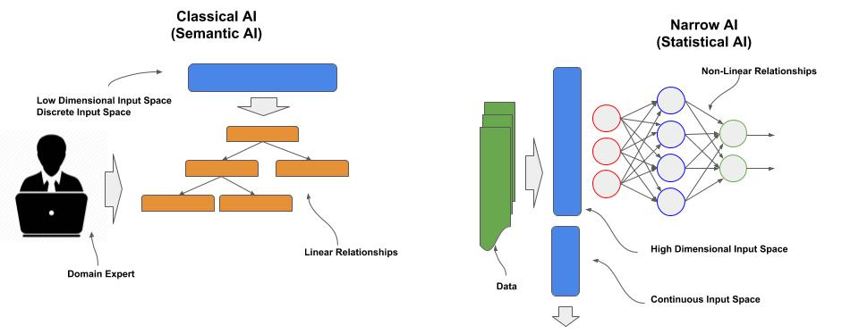
Training Prep & Hyperparameter Tuning
Model is an Algorithm discovered by Machine Learning
A model is an algorithm discovered by machine learning, which can be characterized as:
Having high dimensional input space,
A continuous input space, and
A non-linear relationship between the output behaviors and the input space.

Slide 123
Training Preparation
Training Steps
When training a model, the following steps are typically followed:
Split the dataset into training, eval (validation) and test.
Repeat
Set hyperparameters like batch size and learning rate.
Repeat:
Shuffle the training data.
Feed the training data through the neural network (epoch).
Measure accuracy of the model on the train and eval data per epoch.
Monitor for convergence.
If targets for rate of convergence and accuracy are sufficient, stop training.
Measure final accuracy with the test data.

Slide 124
Training Preparation - Splitting
Splitting the Dataset
Prior to training the model, the [preprocessed] dataset needs to be split into training and test data, where a larger portion of the dataset will be used only for training, and a smaller portion only for testing. The later, test, is sometimes referred to as the holdout set.
In some cases, a portion of the training data is further split off into an eval data, which is sometimes referred to as validation data.
When the training data is large, typically a prior split is made for the eval data. The same eval data is then used at the end of each epoch to estimate what the accuracy will be on the test data; thus the eval data is never used as part of the training.
When the training data is small, a different random portion of the training data is used for validation per epoch, which is referred to cross-validation or rotation-estimation. In this case, eval data is used during training, but not on the specific epoch that it is used to estimate the accuracy on the test data.

Slide 125
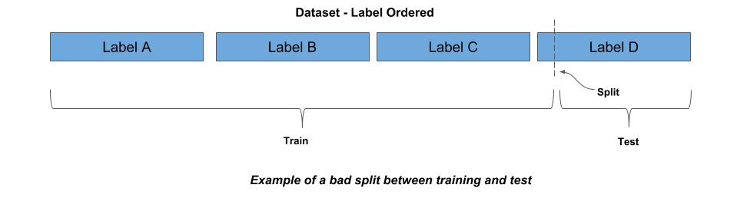
Training Preparation - Shuffling
Shuffling
When a dataset is split, both the training and test data should have the same probability distribution of the labels (classes). For example, if 10% of the data is of label A, then both the training and test data should contain 10% of label A.
A common mistake is to make an arbitrary split of the dataset. It’s not uncommon for datasets to be sequentially ordered by labels. For example, consider a dataset where all the data for label A comes first, then followed by label B, then label C, and so forth. If you made an arbitrary split, say the first 80% of the data is training and the last 20% is test, the training and test will not have the same probability distribution. Worse yet, it’s possible that some labels in the test won’t appear in the train (not learned) and some labels in train won’t appear in test (not verified).

Slide 126
Training Preparation - Stratification
Stratification
The common practice is to randomly shuffle the dataset prior to splitting. If the dataset is sufficiently large, a random shuffle should produce a probability distribution of the labels that is the same in the training and test data.
When the dataset is too small to maintain an equal probability distribution between train and test with a random shuffle, it is a common practice to stratify the data prior to randomly shuffling.
In this case, the data is partitioned into bins by label (stratify), and then random selections are made from the bin according to the probability distribution for the training data. The remaining unselected data becomes the test data.

Slide 127
Training Preparation - CSV File
Random Shuffling from a CSV File Listing
If your processed image data is in a file listing, like a CSV or JSON format, you can make an indirect index in memory to the file listing, and then randomly shuffle the in-memory index. The code below demonstrates using an indirect index to randomly shuffle the dataset as a file listing in a CSV file.
import random # open the CSV file and count (using sum) the number of lines, which equals the # number of samples with open(csv_file) as f: nimages = sum(1 for line in f) # subtract one from the total count if the first line in CSV file is a header if header: nimages -= 1 # create a sequential index between 0 and nimages-1 index = [i for i in range(nimages)] # now randomly sort the index random.shuffle(index)

Slide 128
Training Preparation - JSON File
Random Shuffling from a JSON File Listing
The code below demonstrates using an indirect index to randomly shuffle the dataset as a file listing in a JSON file, where the files are a list ([]) of objects, and each object has the key ‘image’.
dataset = json.load(json_file) nimages = dataset['image'] # create a sequential index between 0 and nimages-1 index = [i for i in range(nimages)] # now randomly sort the index random.shuffle(index)

Slide 129
Training Preparation - Keras
Keras ImageDataGenerator
In Keras, an image dataset can be shuffled and split into training and eval (validation) with the ImageDataGenerator class. This class is used to ingest a dataset for feeding a neural network during training. In the code example below:
The variable model refers to a Keras model that has already been compiled.
x_train and y_train refers to a processed dataset for training (i.e., already split), where x_train typically is a numpy array, with each element a preprocessed image, and y_train typically is a numpy array, with each element the corresponding one-hot encoded label.
The variable datagen is a generator, which is instantiated by ImageDataGenerator for feeding the neural network.
The method flow() sequential moves through the training data (x_train, y_train) in a specified batch size, which is specified as 32 in this example.
The parameter shuffle is set to True, which causes the training data to be shuffled by the generator, at the beginning of each epoch.
Each batch of training data is fed through the neural network using the model’s fit() method.

Slide 130
Training Preparation - Keras
Keras ImageDataGenerator
from keras.preprocessing.image import ImageDataGenerator # x_train and y_train assume the image data and labels have prior preprocessed and # split into training and test data. # instantiate an Image Data generator object datagen = ImageDataGenerator() # the number of batches in an epoch nbatches = len(x_train) // 32 # the number of epochs (training passes over the entire training data) epochs = 10 for epoch in range(epochs): batches = 0 # Use generator to create batches for x_batch, y_batch in datagen.flow(x_train, y_train, batch_size=32, shuffle=True): model.fit(x_batch, y_batch) batches += 1 if batches > nbatches: break

Slide 131
Training Preparation - Keras
Keras ImageDataGenerator - Rescale
In the code below, unlike the previous, the x_train data has not been normalized/standardized. In this case, the parameter rescale is passed to the instantiation of ImageDataGenerator, which will result in the corresponding flow() method normalizing the pixel data (i.e., dividing by 255) while the data is being fed:
from keras.preprocessing.image import ImageDataGenerator # x_train and y_train assume the image data and labels have been resized for the # CNN and split into training and test data, but the data has not been normalized. # instantiate an Image Data generator object and specify normalizing the image data datagen = ImageDataGenerator(rescale=1./255) # feed (train) the neural network

Slide 132
Training Preparation - Keras
Keras ImageDataGenerator - Standardization
In the code below, the rescale parameter is replaced with featurewise_std_normalization, which will standardize the data. Since standardization requires calculating the mean and standard deviation of the pixel data across the entire training set, a call is made the fit() method for the corresponding calculation.
from keras.preprocessing.image import ImageDataGenerator # instantiate an Image Data generator object and specify standardizing the image data datagen = ImageDataGenerator(featurewise_std_normalization=True) # calculate the mean/stddev for standardization datagen.fit(x_train) # feed (train) the neural network

Slide 133
Training Preparation - Keras
Keras ImageDataGenerator - Validation Split
In the code below, the parameter validation_split is added to use 10% of the training data as validation data on each epoch. Additionally, we do a single call for training per epoch (vs. manually batch feeding it), by passing the datagen.flow() generator to the fit_generator():
from keras.preprocessing.image import ImageDataGenerator x_train and y_train assume the image data and labels have been resized for the # CNN and split into training and test data, but the data has not been normalized. # instantiate an Image Data generator object datagen = ImageDataGenerator(rescale=1./255, validation_split=0.1) # the number of epochs (training passes over the entire training data) epochs = 10 for epoch in range(epochs): # Use generator to create batches model.fit_generator(datagen.flow(x_data, y_data, batch_size=32, shuffle=True))

Slide 134
Hyperparameter Tuning
Hyperparameters vs Learned Parameters
Let’s start by explaining the difference between learned parameters and hyperparameters. The learned parameters, are parameters that are learned during training. For neural networks, these typically are the weights on each neural network connection, the biases on each node, and for convolutional neural networks, the filters in each convolutional layer. These learned parameters stay as part of the model when the model is done training.
Hyperparameters are parameters used to train the model, but not part of the trained model itself. That is, once trained the hyperparameters no longer exist. Hyperparameters are used to improve the training of the model, such as for:
How long does it take to train the model?
How fast does the model converge?
Does it find the global optima?
How accurate is the model?
How overfitted is the model?
Another perspective of hyperparameters is that they are a means to measure cost and quality of developing the model.

Slide 135
Hyperparameter Tuning - Epochs
Epochs
The most basic hyperparameter is the number of epochs --though this is now being more commonly replaced with steps. The epochs hyperparameter is the number of times you will pass the entire training data through the neural network during training. Training is very expensive in compute time. It includes both the forward feed to pass the training data through and the backward propagation to update (train) the model’s parameters. For example, if a full pass of the data (epoch) takes 15 minutes and we run 100 epochs, the training time will take 25 hrs.

Slide 136
Hyperparameter Tuning - Epochs
Overtraining
Early presumptions on training was that the more times your feed the training data, the better the accuracy. What we’ve found, particularly on larger and more complex networks that there is a point where the accuracy will degrade. Today, we now look for convergence on an acceptable local optima for the purpose of how the model will be used in an application. If we overtrain the neural network, the following can happen:
The neural network becomes overfitted to the training data, showing increasing accuracy on the training data, but degrading accuracy on the test data.
In deeper neural networks, the layers will learn in a non-uniform manner and have different convergence rates. Thus, as some layers are working to convergences, others may have convergence and start diverging.
Continued training may cause the neural network to pop out of one local optima and start converging on another local optima, that is less accurate.

Slide 137
Hyperparameter Tuning - Epochs
Overtraining
Let’s start with a simple convnet model in Keras using the CIFAR-10 dataset to demonstrate the concept of convergence and then diverging. In the model, we have intentionally left out methods which prevent overfitting, like dropout or batch normalization.
from keras.datasets import cifar10 # load the Keras builtin CIFAR-10 dataset (x_train, y_train), (x_test, y_test) = cifar10.load_data() # … deleted for brevity # Train the model epochs=20 batch_size=32 model.fit(x_train, y_train, batch_size=batch_size, epochs=epochs, verbose=1, validation_data=(x_test, y_test))

Slide 138
Hyperparameter Tuning - Epochs
Overtraining
Below are the stats for the first six epochs. You can see with each pass there is a steady reduction in loss, which means the neural network is getting closer to fitting the data. Additionally, the accuracy on the training data is going up from 48.75% to 88.3% and on the validation data from 61.26% to 69.23%.
Train on 50000 samples, validate on 10000 samples Epoch 1/20 50000/50000 [==============================] - 61s 1ms/step - loss: 1.4311 - acc: 0.4875 - val_loss: 1.1157 - val_acc: 0.6126 Epoch 2/20 50000/50000 [==============================] - 59s 1ms/step - loss: 0.9873 - acc: 0.6536 - val_loss: 1.1588 - val_acc: 0.5883 Epoch 3/20 50000/50000 [==============================] - 59s 1ms/step - loss: 0.8072 - acc: 0.7197 - val_loss: 1.0325 - val_acc: 0.6475 Epoch 4/20 50000/50000 [==============================] - 59s 1ms/step - loss: 0.6512 - acc: 0.7736 - val_loss: 1.0646 - val_acc: 0.6469 Epoch 5/20 50000/50000 [==============================] - 58s 1ms/step - loss: 0.4972 - acc: 0.8293 - val_loss: 0.9752 - val_acc: 0.6908 Epoch 6/20 50000/50000 [==============================] - 58s 1ms/step - loss: 0.3479 - acc: 0.8830 - val_loss: 1.0822 - val_acc: 0.6923

Slide 139
Hyperparameter Tuning - Epochs
Overtraining
Let’s now look at epochs 11 thru 20. You can see that we’ve hit a 100% on the training data, which means we are tightly fitted to the training data. On the other hand, our accuracy on the validation data plateaued at 69.96%. Thus, after six epochs, there was no improvement from continued training, and we can conclude that by epoch 7 the model was overfitted to the training data.
Epoch 11/20 50000/50000 [==============================] - 58s 1ms/step - loss: 0.0198 - acc: 0.9944 - val_loss: 2.0663 - val_acc: 0.6915 Epoch 12/20 50000/50000 [==============================] - 59s 1ms/step - loss: 0.0112 - acc: 0.9970 - val_loss: 2.1746 - val_acc: 0.6939 # … deleted for brevity Epoch 18/20 50000/50000 [==============================] - 59s 1ms/step - loss: 8.6766e-05 - acc: 1.0000 - val_loss: 2.6870 - val_acc: 0.6994 Epoch 19/20 50000/50000 [==============================] - 58s 1ms/step - loss: 2.3760e-05 - acc: 1.0000 - val_loss: 2.7450 - val_acc: 0.6991 Epoch 20/20 50000/50000 [==============================] - 59s 1ms/step - loss: 1.5005e-05 - acc: 1.0000 - val_loss: 2.7683 - val_acc: 0.6996

Slide 140
Hyperparameter Tuning - Steps
Steps
Over the course of the last few years, a lot of insights have been learned by researchers and practitioners on how neural networks learn. These insights have lead to focusing on regularization, normalization, augmentation, and sampling distributions. In shorter words, we can improve accuracy and reduce training time by changing the sampling distribution of the training dataset.
In epochs, we think of a sequential draw of batches from our training data. Even though we randomly shuffle the training data at the start of each epoch, the sampling distribution is still the same.

Slide 141
Hyperparameter Tuning - Steps
Learning the Best Sampling Distribution
With data augmentation, we create new samples by modifying existing samples within a set of parameters, from which we randomly select the modification, which also contributes to changing the distribution.
With batch normalization, regularization/dropout and data augmentation, no two epochs will have the same sampling distribution. In this case, the practice now is to limit the number of random draws from each new sampling distribution, which is referred to as steps. For example, if steps is set to 1000, then per epoch, only a 1000 random batches will be selected and feed into the neural network for training.
In Keras, we can specify both the number of epochs and steps as parameters to the fit() or fit_generator() methods:
model.fit(x_train, y_train, batch_size=32, epochs=10, steps_per_epoch=1000)

Slide 142
Hyperparameter Tuning - Batch Size
Batch Size
To understand how to set batch size, you should have a basic understanding of the three types of gradient descent algorithms; wherein the gradient descent algorithm is the means by which the model parameters are updated (learned) during training.
Stochastic Gradient Descent
Batch Gradient Descent
Mini-Batch Gradient Descent (conventional method today)

Slide 143
Hyperparameter Tuning - Batch Size
Batch Size - Mini-Batch Gradient Descent
The mini-batch gradient descent method is a tradeoff between stochastic and batch gradient descent. Instead of one sample or all samples, the neural network is fed in mini-batches which are a subset of the entire training data.
The smaller the mini-batch side, the more the training will resemble stochastic gradient descent, while larger batch sizes will resemble batch gradient descent.
For certain models and datasets, stochastic gradient descent (SGD) works best. In general, it’s a common practice to use the trade-off of mini-batch gradient descent. The hyperparameter batch_size is the size of the mini-batch. Due to hardware architectures, the most time/space efficient batch sizes are multiples of 8, such as 8, 16, 32 and 64. The batch_size that is most commonly tried first is 32. One generally never sees a batch size greater than 128.

Slide 144
Hyperparameter Tuning - Batch Size
Mini-Batch Size in Keras
In Keras, you can specify the batch_size either in the model fit()/fit_generator() methods:
Alternately, if using the ImageDataGenerator, batch_size can be specified in the corresponding flow()/flow_from_directory()/flow_from_dataframe() methods:
# model is a compiled keras model (Model or Sequential class). model.fit(x_train, y_train, batch_size=32)
# randomly rotate images +/- 20 degrees datagen = ImageDataGenerator(rotation_range=20) # train the model model.fit_generator(datagen.flow(x_train, y_train, batch_size=32), epochs=10)

Slide 145
Hyperparameter Tuning - Learning Rate
Learning Rate
The learning rate is generally the most influential of the hyperparameters. It can have a significant impact on:
The length of time to train a neural network.
Whether the neural network converges on a local optima.
Whether it converges on the best (global) local optima.
When doing updates to the model parameters during the backward propagation pass, the gradient descent algorithm is used to derive a value to add/subtract to the parameters in the model from the loss function for that pass.
These additions and subtractions could result in large swings in parameter values. If a model has and continues to have large swings in parameter values, the model will be ‘all over the map’ and never converge.

Slide 146
Hyperparameter Tuning - Convergence
Convergence
What is convergence? This is when there is a steady reduction in the loss (referred to as minimizing the loss) and a steady increase or plateau in the accuracy per pass. If you observe big swings in the amount of loss and/or accuracy, then the training of your model is not converging.
If the training is not converging, it won’t matter how many epochs you run, it will never finish training.
The learning rate provides us with a means to control the degree that the model parameters are updated. In the basic method, the learning rate is a fixed coefficient between 0 and 1 that is multiplied against the value to add/subtract, to reduce the amount being added or subtracted. These smaller increments add more stability during the training and increase the likelihood of convergence.

Slide 147
Hyperparameter Tuning - Learning Rate
Small vs. Large Learning Rate
If we use a very small learning rate, like 0.001, we will eliminate large swings in the model parameters during updates. This will generally guarantee that the training will converge on a local optima.
But there is a drawback. First, the smaller we make the increments, the more passes of the training data (epochs) will be needed to minimize the loss. That means more time to train.
Second, the smaller the increments the less likely the training will explore other local optimas, which might be more accurate than the one that the training is converging on; instead, it may converge on poor local optima or get stuck on a saddle point.

Slide 148
Hyperparameter Tuning - Learning Rate
Small vs. Large Learning Rate
A large learning rate, like 0.1, likely will cause big jumps in the model parameters during updates. In some cases, it might initially lead to faster convergence (less epochs).
The drawback is that even if you are initially converging fast, the jumps may overshoot and start causing the convergence to swing back and forth, or hops across different local optima. At very high learning rates, the training may start to diverge (i.e., increasing loss).
There are a lot of factors of what will be the best learning rate at different times during the training. In best practices the rate will range between 0.1 and 10e-5.
Below is a basic formula of how a weight is adjusted by multiplying the learning rate by the amount calculated to add/subtract (gradient):
weight += -learning_rate * gradient

Slide 149
Hyperparameter Tuning - Optimizers
Optimizers
For Keras, these learning rate algorithms are specified when the optimizer is defined for minimizing the loss function.
from keras import optimizers # instantiate an optimizer optimizer = optimizers.RMSprop(lr=0.001, rho=0.9, epsilon=None, decay=0.0) # compile the model, specifying the loss function and optimizer model.compile(loss='mean_squared_error', optimizer=optimizer)

Slide 150
Hyperparameter Tuning - Feeding
Training Feeders
To train a neural network, the training data is fed through the neural network in a forward pass either as individual samples (stochastic), batches (mini-batch) or an epoch (batch) at a time, followed by a backward propagation pass to update the parameters of the model.
This process is referred to as feeding the neural network, and the mechanisms for feeding the neural network are called feeders.

Slide 151
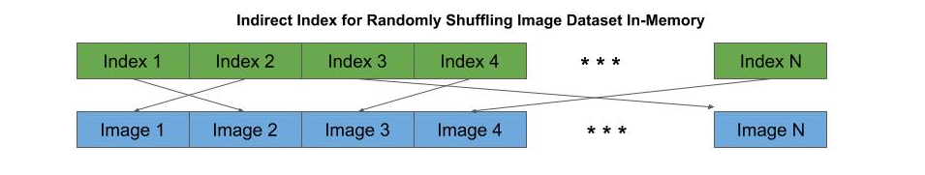
Feeders - In-Memory
In-Memory Feeder
The most efficient (fastest) way to feed a neural network for training is to use an in-memory feeder. Typically, the preprocessed image data is stored as a contiguous region of memory. The feeder uses an indirect index to each preprocessed image in memory, by which the feeder can randomly shuffle, draw batches, and do transforms without moving memory.
batch_size = 32 # the mini-batch size epochs=10 # the number of epochs # once the model is compiled and the image data has been preprocessed, # the fit method will start training the model, where x_train and y_train # are the preprocessed image data and one-hot encoded labels model.fit(x_train, y_train, batch_size=batch_size, epochs=epochs)

Slide 152
Feeders - In-Memory
In-Memory Generator Feeder
The fit_generator() method is similar to the fit() method, but uses a generator, which is constructed with the ImageDataGenerator class. This generator enables image augmentation, where augmented images are generated on-the-fly as the neural network is being fed. The flow() method of the data generator then constructs mini-batches which consist of a combination of the original images and augmented versions.
# randomly rotate images +/- 20 degrees datagen = ImageDataGenerator(rotation_range=20) # train the model using the flow() method of the generator to create mini-batches model.fit_generator(datagen.flow(x_train, y_train, batch_size=32), epochs=10)

Slide 153
Feeders - On-Disk
On-Disk Generator Feeder
If your memory resources are not sufficient to hold the entire preprocessed dataset in memory, then you will need to continuously feed the neural network by drawing batches from the on-disk storage of the preprocessed (or original) image data.
The drawback is that for each mini-batch, the generator must re-read the preprocessed (or original) data from the disk.
In the code below, we first create a generator using the ImageDataGenerator class, which we will use in conjunction with the flow_from_directory() method.
# normalize the pixel data (rescale) as its read from memory, and # randomly rotate images +/- 20 degrees datagen = ImageDataGenerator(rescale=1/255., rotation_range=20) # train the model using the flow_from_directory() method model.fit_generator(datagen.flow_from_directory('dataset', target_size=(128,128), batch_size=32), epochs=10)

Slide 154
Test Data
Test Data
The test data, also known as the hold-out set, is the portion of the dataset that was not used in training. These are samples that the model never saw during training. Once the model has been trained with the training data, a forward pass is made through the trained model (referred to as evaluation) to predict the likely accuracy the model will have when deployed and predicting (inference) on samples it has not seen before.
Generally, the accuracy of the test data is slightly less than that of the training data.
If though there is a large difference between the training accuracy (high) and the test accuracy (low), then the model is overfitted to the training data.
In Keras, once the model has been trained, we use the evaluate() method to obtain the accuracy on the test data.
# Evaluate the model using the test (hold-out) data score = model.evaluate(x_test, y_test) print("Test Accuracy", score[1])

Slide 155
Training and Deployment
Training Cycle
Let’s start by discussing the training cycle, before we do a deep dive. The general phases of training are:
Pretraining - find best hyperparameters for training. Repeat:
Set initial hyperparameters.
Run a partial training session.
Examine rate of changes in accuracy and loss on training and validation data.
If acceptable, stop pre-training phase.
Set training objectives:
for accuracy on validation data.
rate of progression in reducing loss on training data.
Plan number of epochs or steps to meet objectives.
Training:
Start full training.
If objective meet, early stop and checkpoint model
If diverging from objectives, terminate training

Slide 156
Pretraining
Pretraining
The purpose of the pretraining phase is to find the best hyperparameter settings to initiate a full training run. Let’s revisit what goes wrong when the wrong hyperparameters are used during training:
It takes an excessive time to train the model.
The model gets stuck on a saddle point and never converges.
The model becomes overfitted and diverges.

Slide 157
Weights Initialization
Weights/Biases Initialization
When training starts, all the weights and biases need an initial value. Those initial values can impact how long and how accurate the model will be, even when everything else is right.
If we initialize the weights to zero, then all the updates to the weights in the neural network during training will be the same --i.e., the neurons will be symmetric. As a result, the network is the same as a single neuron.
For biases, this is not the case, and the current practice is to initialize them to zero.

Slide 158
Weights Initialization
Uniform Random Distribution
For the weights, they are initialized by some random distributions. A uniform random distribution will generate produce a good result. But practices have shown that a uniform distribution can result in significant variance in the final accuracy.
In the past, using a uniform random distributions, several instances of the model would be trained in parallel with different uniform random distributions.
In 2010, a paper by Xavier Glorot demonstrated that drawing a random distribution from a Gaussian distribution with a mean of zero resulted more consistently in obtaining the best accuracy. The specific distribution, known now as Xavier initialization, works best when the activation function for hidden units is a tanh.
In 2015, a variant of Xavier known as He, was found to work best when the activation function for the hidden units was a ReLU or Leaky ReLU.

Slide 159
Weights Initialization
He-Normal Initialization
Keras supports a large variety of random initializers. By default, the weights are initialized by a uniform random distribution and the biases are set to zero. Since CNN use ReLU and Leaky ReLU activations for the convolutional and dense layers, the best practice today is to initialize the weights using the He initialization.
from keras import initializers # initialize the weights using He initialization when activation function is ReLU model.add(Dense(128, kernel_initializer='he_normal')) model.add(ReLU())

Slide 160
Learning Rate (Grid) Search
Learning Rate (Grid) Search
What you’re trying to achieve here is to find the highest initial learning rate that:
Makes the fastest route to convergence on initial training start,
Prevents the training from being stuck on a saddle point, but:
Not so large, that it either:
Bounces around different local optima, or
Dives into a poor local optima.
On the other hand, one does not want to pick an initial learning rate on the lowest end, that:
Increases training time to converge,
Gets stuck or a saddle point, or
Does not explore for better local optimas.

Slide 161
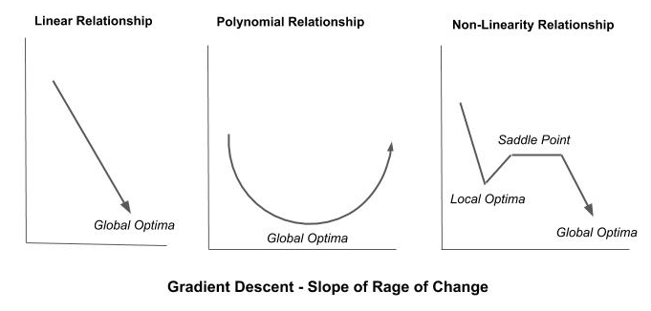
Learning Rate / Gradient Descent
Learning Rate and Gradient Descent
In the simplified third example depicted below, the function f(x) is comprised of segments of non-linearity. In addition to a global optima, we depict a local optima which the training could dive into and converge on, overlooking the global optima. Likewise is a saddle point. This is a plateaued region of the slope. If our learning rate is too small, one might bounce back and forth on the plateau and never escape.

Slide 162
Learning Rate / Optimizer
Optimizer
In Keras, optimizers can be specified in two ways.
As a string value to the parameter optimizer in the compile() method. In this case, the selected optimizer is configured with default settings.
An optimizer can also be specified from the optimizer class, and configured when the optimizer object is instantiated. In this case, the selected optimizer is configured with a learning rate of 0.01.
model.compile(optimizer='rmsprop', loss='categorical_crossentropy', metrics=['accuracy'])
from keras import optimizers optimizer = optimizers.RMSProp(lr=0.01) model.compile(optimizer=optimizer, loss='categorical_crossentropy', metrics=['accuracy'])

Slide 163
Checkpointing
Checkpointing
Checkpointing is periodically saving the learned model parameters and current hyperparameter values during training. There are two reasons for doing this:
To be able to resume training of a model without restarting the training (where it left off).
Identify a past point training that the model gave the best results.
In the former case (resume training), for resource management one may split the training across sessions. For example, one might reserve (or be authorized) one hour a day for training. At the end of the one hour training each day, the training is checkpointed. The following day, training is resume by restoring from the checkpoint.

Slide 164
Transfer Learning and Pre-built Models
Pre-Built Models
The Keras framework comes with a number of pre-built models, which you can use either as-is to train a new model, or modify and/or fine-tune for transfer learning. These models are based on best-in-class models for image classification, which have been award winning models in competitions like ImageNet.
The pre-built model architectures include:
Sequential CNN
VGG16, VGG19
Residual CNN
ResNet
Wide Layer CNN ResNeXt, Inception
Advanced CNN DenseNet, Xception, NASNet
Mobile
MobileNet

Slide 165
Transfer Learning and Pre-built Models
Importing Pre-Built Models
The pre-built Keras models are imported from the keras.applications module. Below are some examples:
from keras.applications import VGG16 from keras.applications import VGG19 from keras.applications import ResNet50 from keras.applications import InceptionV3 from keras.applications import InceptionResNetV2 from keras.applications import DenseNet121 from keras.applications import DenseNet169 from keras.applications import DenseNet201 from keras.applications import Xception from keras.applications import NASNetLarge from keras.applications import NASNetMobile from keras.applications import MobileNet

Slide 166
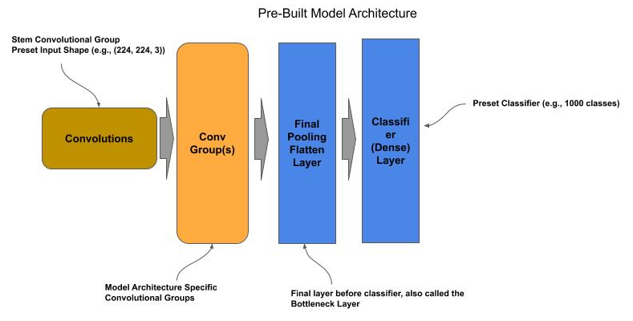
Pre-built Models
Base Model
By default, the pre-built models are complete but untrained (i.e., the weights and biases are randomly initialized). Each untrained pre-built model is configured for a specific input shape and number of output classes. In most cases the input shape is either (224, 224, 3) or (299, 299, 3). The models will also take input in channel first format as in (3, 224, 224) and (3, 299, 299). In most cases, the number of output classes is 1000.

Slide 167
Pre-built Models
Compiling the Base Model
The pre-built models do not have an assigned loss function and optimizer. Prior to using them, one must issue the compile() method to assign the loss, optimizer and performance measurements.
from keras.applications import ResNet50 # Get a pre-built ResNet50 model model = ResNet50() # Compile the model for training model.compile(loss='categorical_crossentropy', optimizer='adam', metrics=['accuracy']) # Now train the model

Slide 168
Pre-trained Models
New Classifier
The final classifier layer in all the pre-built models can be removed and replaced with a new classifier. The new classifier can then be used to train the pre-built model for a new dataset and set of classes.
The classifier layer is referred to as the top layer. When instantiating an instance of a pre-built model:
Set the parameter include_top to False to get an instance without the classifier.
When the include_top=False, one can also reset the input shape of the model with the parameter input_shape.

Slide 169
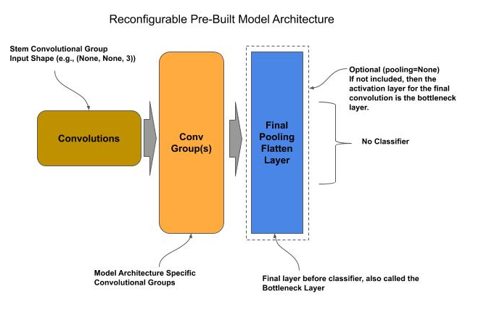
Pre-trained Models
Reconfiguring a Pre-Built Model

Slide 170
Pre-trained Models
Adding a New Classifier
In the code below, we instantiate a pre-built ResNet model and replace it with a new classifier for 20 classes:
from keras.applications import ResNet50 from keras.layers import Dense # Get a pre-built model for input shape (100,100,3) and without the classifier model = ResNet50(include_top=False, input_shape=(100, 100, 3), pooling='avg') # Add a classifier for 20 classes model.add(Dense(20, activation='softmax')) # Compile the model for training model.compile(loss='categorical_crossentropy', optimizer='adam', metrics=['accuracy']) # Now train the model

Slide 171
Pre-trained Models
Final Pooling Layer
For most models, the final layer preceding the classifier is a global average pooling layer. This layer acts as both a final pooling layer for the feature maps and a flatten operation (convert to 1D vector). One might want to replace this layer with one’s own custom final pooling/flatten layer. In this case, one either specifies the parameter pooling to None.
from keras.applications import ResNet50 from keras.layers import Dense, Flatten from keras import Model # Get a pre-built model for input shape (100,100,3) and without the classifier model = ResNet50(include_top=False, input_shape=(100, 100, 3), pooling=None) # Flatten the Feature Maps into a 1D vector output = Flatten()(model.output) # Add a classifier for 20 classes output = Dense(20, activation='softmax')(output) # Compile the model for training model = Model(model.input, output) model.compile(loss='categorical_crossentropy', optimizer='adam', metrics=['accuracy']) # Now train the model

Slide 172
Transfer Learning
Transfer Learning
Transfer learning is where one uses pretrained models for one task and retrain the classifier and/or fine-tune layers for a new task.
There are two general approaches to transfer learning:
Similar Tasks (Image Domains)
Distinct Tasks

Slide 173
Transfer Learning - Similar Tasks
Similar Tasks
When deciding on the approach, we look at the similarity of the source (pre-trained) domain of images and the destination (new) domain.
The more similar, the more of the existing bottom layers we can reuse without training.
For example, if one had a model trained on fruits, it’s probably that all of the bottom layers of the pretrained model can be reused (without retraining) for building a new model to recognize vegetables.

Slide 174
Transfer Learning - Similar Tasks
Similar Tasks
For similar tasks, we assume that:
The coarse features learned at the bottom-most layers will be the same for the new classifier,
The grouping of coarse features in the middle layers and final assembly into details all can be reused as-is, prior to entering the topmost layer(s) for classification.
When the source and destination domains have this high level of similarity, we generally can:
Replace the existing topmost classifier layer with a new classifier layer,
Freeze the lower layers and train only the classifier layer.
Since we don’t need to learn the weights/biases for the other layers, we can generally train a model for the new domain with substantially less data and fewer epochs.

Slide 175
Transfer Learning - Similar Tasks
Similar Tasks - Freezing Layers
We modify the code to freeze all the layers preceding the topmost classifier layer prior to training. Freezing prevents the weights/biases of the layer(s) from being updated during training.
In Keras, each layer has the property freeze, which defaults to True.
Use a pre-built model with pre-trained weights/biases (ImageNet 2012),
Drop the existing classifier from the pre-built model (topmost layer).
Freeze the remaining layers.
Add a new classifier layer.
Train the model through transfer learning.

Slide 176
Transfer Learning - Similar Tasks
Retraining a ResNet-50 Model
from keras.applications import ResNet50 from keras.layers import Dense from keras import Model # Get a pre-trained/pre-built model without the classifier and retain the global # average pooling # layer following the final convolution (bottleneck) layer model = ResNet50(include_top=False, pooling='avg', weights='imagenet') # Freeze the weights of the remaining layer for layer in model.layers: layer.trainable = False # Add a classifier for 20 classes output = Dense(20, activation='softmax')(model.output) # Compile the model for training model = Model(model.input, output) model.compile(loss='categorical_crossentropy', optimizer='adam', metrics=['accuracy']) # Now train the model

Slide 177
Transfer Learning - Distinct Tasks
Distinct Tasks
When the source and destination domain of the image datasets are non-similar, one starts with the same steps as in the similar task approach above, but then follows up with fine-tuning the bottom layers. The steps in this approach generally are:
Add a new classifier layer and freeze the remaining layer.
Train the new classifier layer the target number of epochs.
Repeat for fine-tuning:
Unfreeze the next bottom-most convolutional group
(moving in direction of top to bottom)
Train for a few epochs to fine-tune.
Once the convolutional groups are fine-tuned:
Unfreeze the convolutional stem group
Train for a few epochs to fine-tune

Slide 178
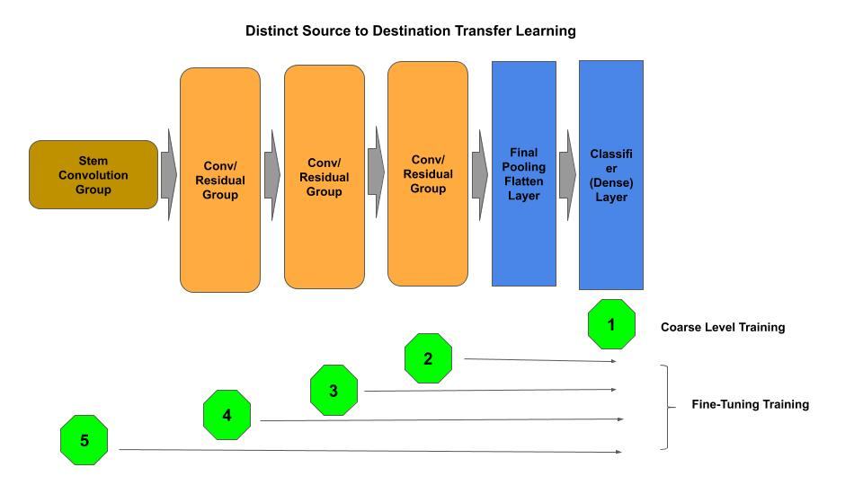
Transfer Learning - Distinct Tasks
Distinct Tasks - (Re)Training Overview

Slide 179
Transfer Learning - Distinct Tasks
Transfer Learning - Coarse Training
In the next code example, we start with a a coarse training for the add classifier level, followed by fine-tuning of each convolutional (residual) group and finally the stem convolutional group.
# Deleted for brevity ... # Freeze the weights of the remaining layer for layer in model.layers: layer.trainable = False # Add a classifier for 20 classes output = Dense(20, activation='softmax')(model.output) # Compile the model for training model = Model(model.input, output) model.compile(loss='categorical_crossentropy', optimizer='adam', metrics=['accuracy']) # Coarse Level Training of the classifier model.fit(x_data, y_data, batch_size=32, epochs=50, validation_split=0.2)

Slide 180
Transfer Learning - Distinct Tasks
Transfer Learning - Finer Training
Next we will do the fine-tuning of each convolutional (residual) group. The first step below, we scan through the model building a list of the residual groups, and convolutional layers within the group, in sequential order.
stem = None # layer that is the convolutional layer for the stem group groups = [] # the add layer for each convolutional group conv2d = [] # the convolutional layers of a group first_conv2d = True for layer in model.layers: if type(layer) == layers.convolutional.Conv2D: # In ResNet50, the first Conv2D is the stem convolutional layer if first_conv2d == True: stem = layer first_conv2d = False # Keep list of convolutional layers per convolutional group else: conv2d.append(layer) # Each convolutional group in Residual Networks ends with a Add layer. # Maintain list in reverse order (top-most conv group is top of list) elif type(layer) == layers.merge.Add: groups.insert(0, conv2d) conv2d = []

Slide 181
Transfer Learning - Distinct Tasks
Transfer Learning - Finer Training
Next, we fine-tune train each convolutional group, sequentially from the top-most group proceeding to the bottom-most, for a smaller number of epochs (5) than the coarse training. Finally, we fine-tune train the stem convolutional group.
# Unfreeze a convolutional group at a time (from top-most to bottom-most) # And fine-tune (train) that layer for i in range(1, len(groups)): # Unfreeze the convolutional layers in this conv/residual group for layer in groups[i]: layer.trainable = True # re-compile the model for training model.compile(loss='categorical_crossentropy', optimizer='adam', metrics=['accuracy']) # Fine-tune train the convolutional group(s) model.fit(x_data, y_data, batch_size=32, epochs=5) # Unfreeze the stem convolutional and do a final fine-tuning stem.trainable = True model.compile(loss='categorical_crossentropy', optimizer='adam', metrics=['accuracy']) model.fit(x_data, y_data, batch_size=32, epochs=5, validation_split=0.2)

